Slide 1
AGM 2021
18.09.21 Vic Borrill

Slide 2
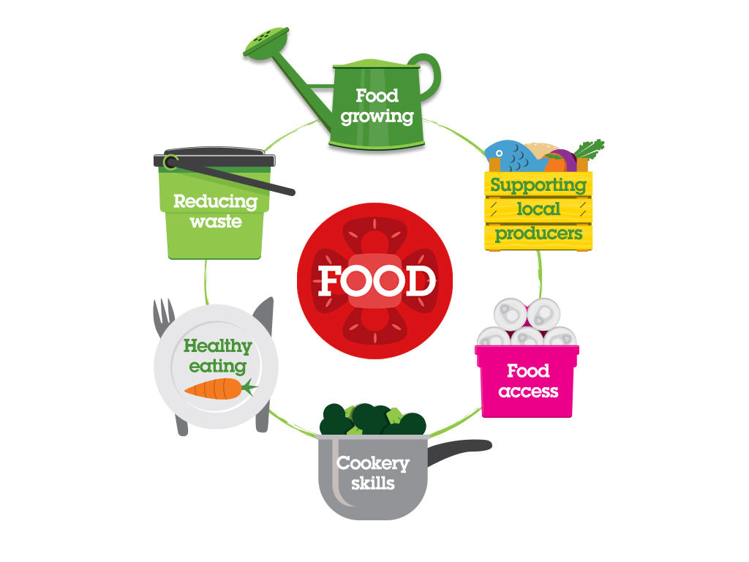
Brighton & Hove Food Partnership
BHFP is an independent, ‘not for profit’ established in 2003 that helps people learn to cook, to eat a healthy diet, to grow their own food and to waste less food.
Work with individuals
Work with groups
Work with caterers and food businesses
Work at a strategy and policy level
Whilst 2020-21 was a year like no other we were able to step up and help our city during the Covid-19 pandemic because of our track record and partnership approach

Slide 3

Our work
Our aims:
Connect – to be a hub and network builder
Inspire – to inspire, support and encourage people to adopt healthier, more sustainable diets and lifestyles
Champion – to champion and support community led food projects
Influence - to influence the behaviour of large organisations
Lead – to operate at a strategic level.
Care – to be a well run organisation with happy and motivated staff and volunteers and to take environmental and ethical responsibility

Slide 4
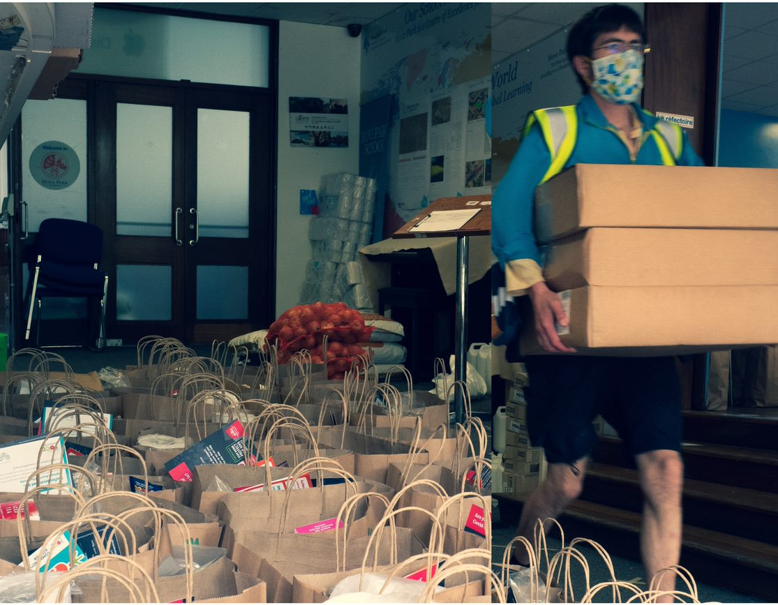
Connect – to be a hub and network builder
Covid-19 emergency food response
Expanded Emergency Food Network
Link to BHCC Food Cell
Food distribution hub
Deliver on the day parcels
Link to CVS
Link to business
Food purchasing incl Food Factory
Funding
Info – web, printed, phone
……… All adapted over time and still adapting
Notes:
Covid-19 emergency food response
Emergency Food Network and expanded with temp food hubs (50 projects)
Co-chair Food Cell with Brighton & Hove City Council
Central processing hub
Delivery of food parcels for those isolating
Links to other food provision eg Ageing Well and Together Co and between community gardens and food projects
Work with Food Factory Link to local suppliers
Link to local food businesses
Crowdfunding and fundraising
Information on our website, via phone calls and social channels
….. Continue this work as we move to ‘what next’

Slide 5

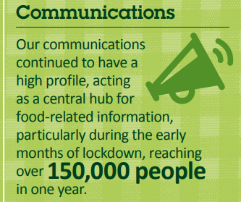

Hub for information – sharing info from us and those we work with – print, online, social

Slide 6
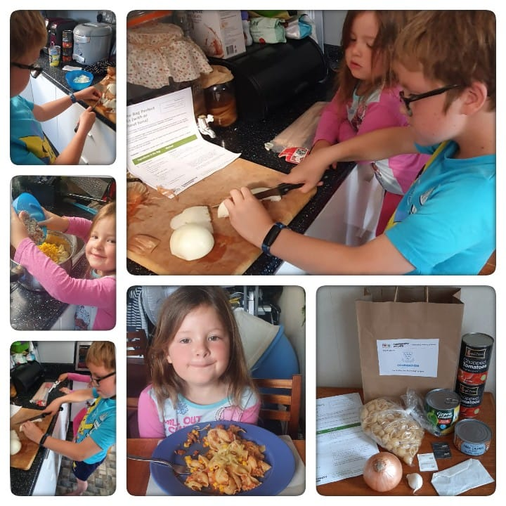
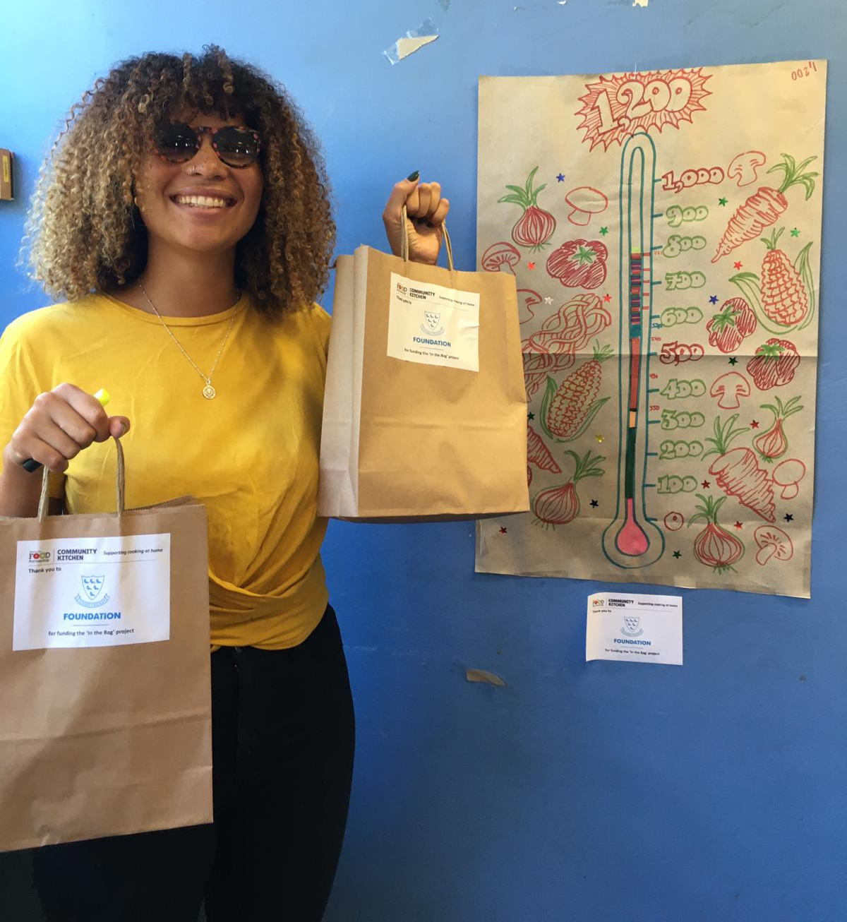
Inspire, support and encourage people to adopt healthier, more sustainable diets and lifestyles
Community Kitchen – even when closed 40+ cookery & nutrition webinars reached 500 people
In The Bag- 20,000 recipe kits
Cooking with limited equipment & Eating Well as you age booklets
Eating well as you Age

Slide 7
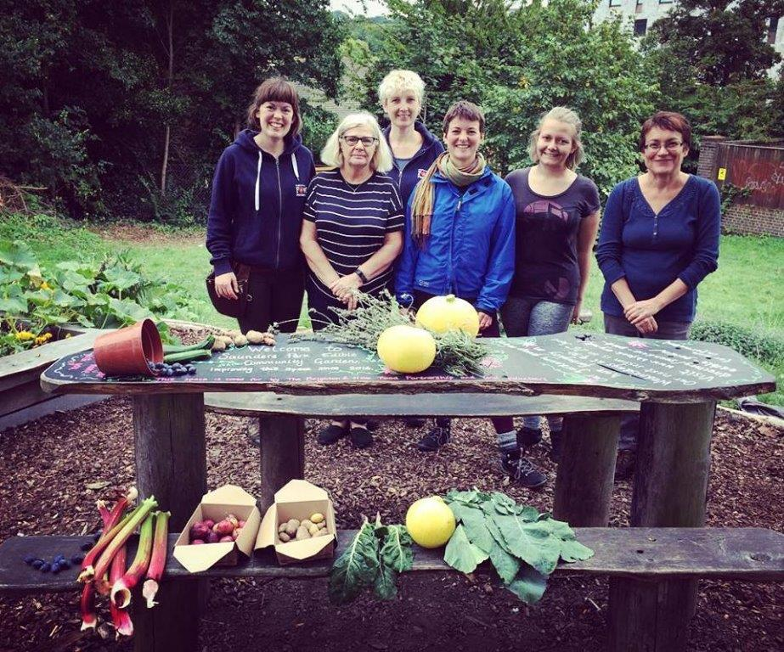
Gardens
Dementia Gardening
Preston Park and Saunders Park food growing spaces
Wellbeing Gardens at Stanmer

Slide 8
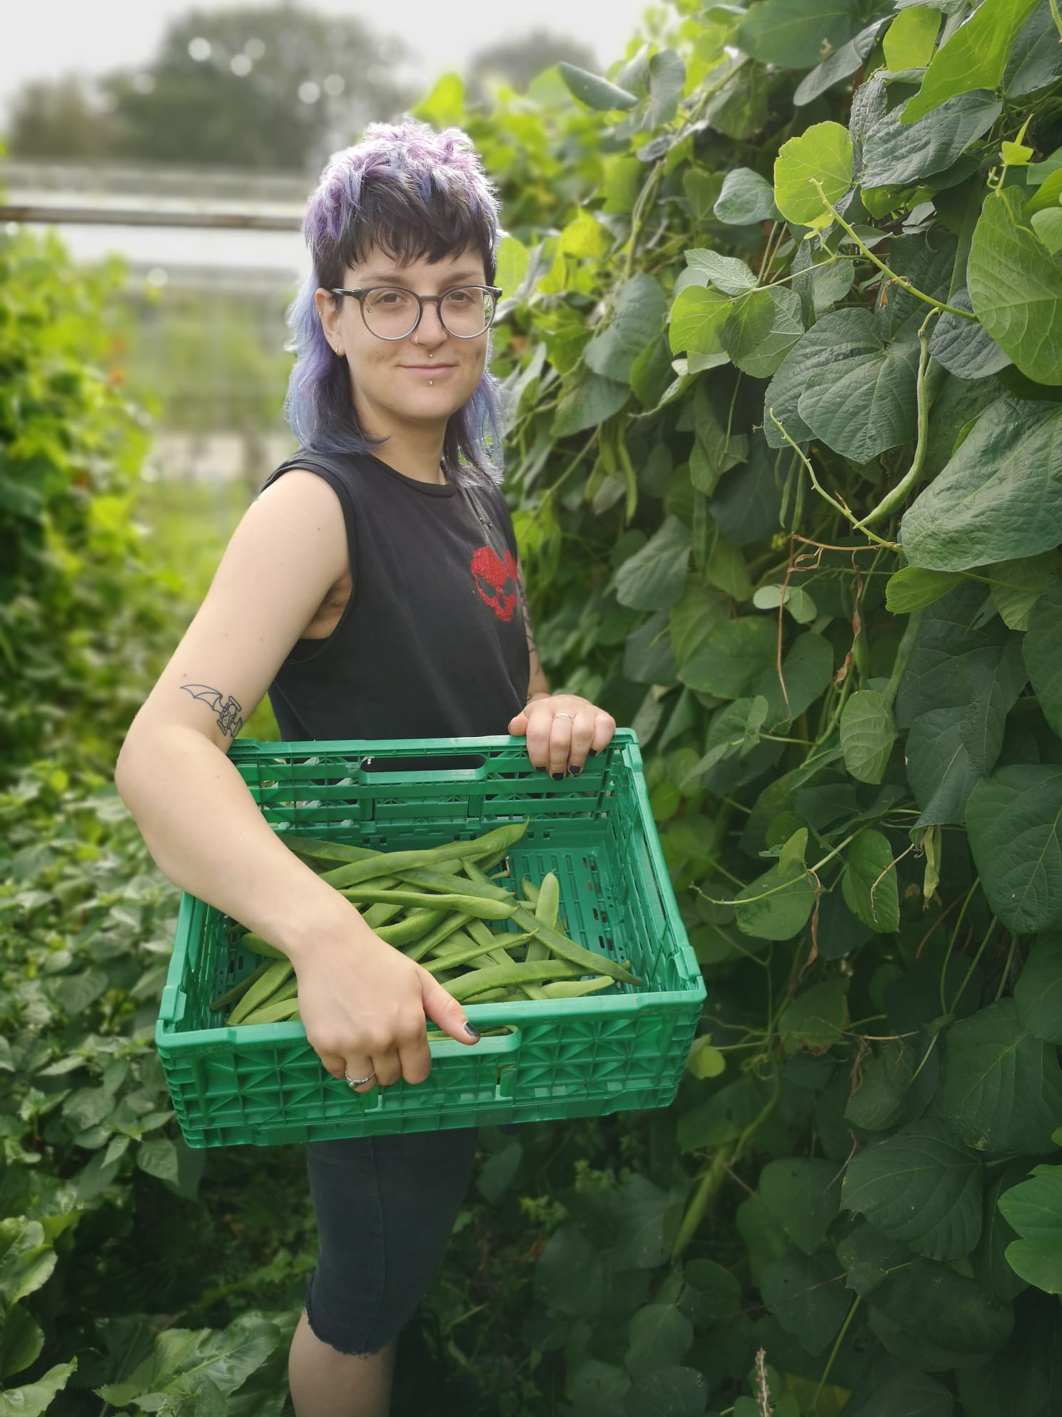
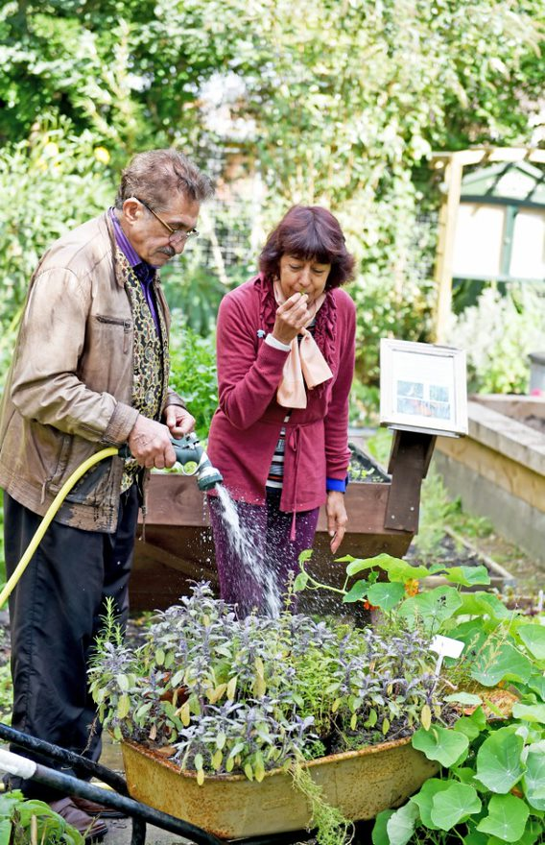
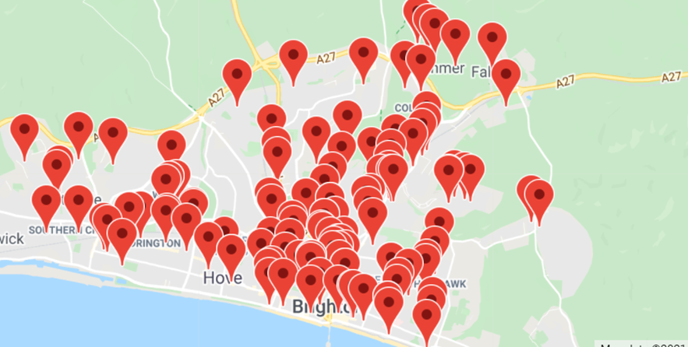
Champion and support community led food projects
Green Wellbeing Alliance
Surplus Food Network
Emergency Food Network
Affordable Food Projects (new in 2020/21)
Shared meal projects
Community food growing spaces

Slide 9
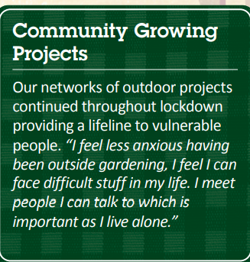

Green Wellbeing Alliance
10 small organisations working together across Sussex to provide outdoor therapeutic activities
BHFP led bid to BHCC for funds for partners
BHFP organise training, networking meetings and shared website
During Covid-19 shared info on safer operating to enable projects toopen and provide a lifeline to vulnerable people
21,178 hours contributed by 117 volunteers From 1 April 2020 to 31 March 2021.
BHFP also provides links to other areas eg Community Kitchen and outdoor cookery
www.greenwellbeingalliance.org.uk

Slide 10
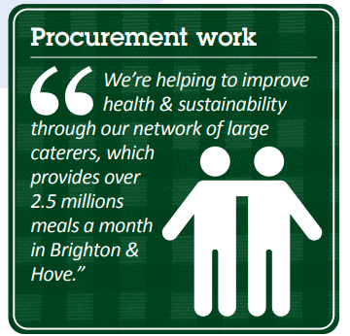
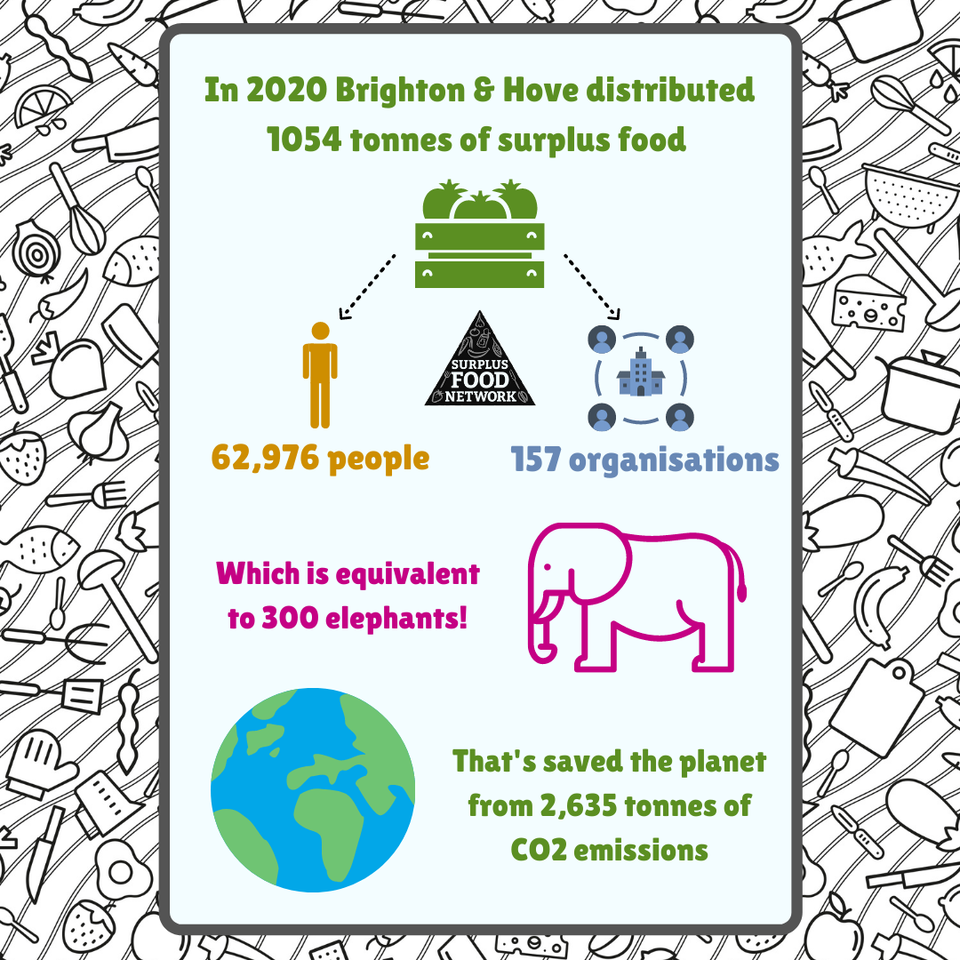
To influence the behaviour of large organisations

Slide 11
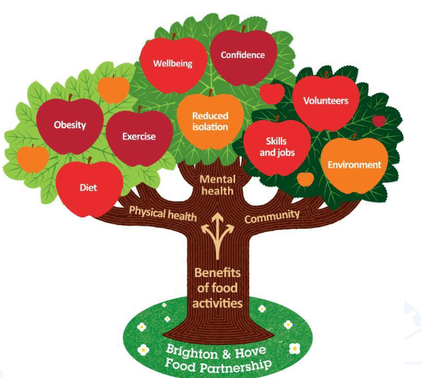
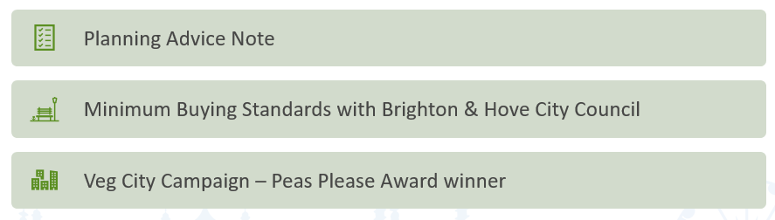




Lead – to operate at a strategic level. Lead city’s Food Strategy and advocate using food as a policy tool to achieve health, wellbeing and sustainability outcomes

Slide 12

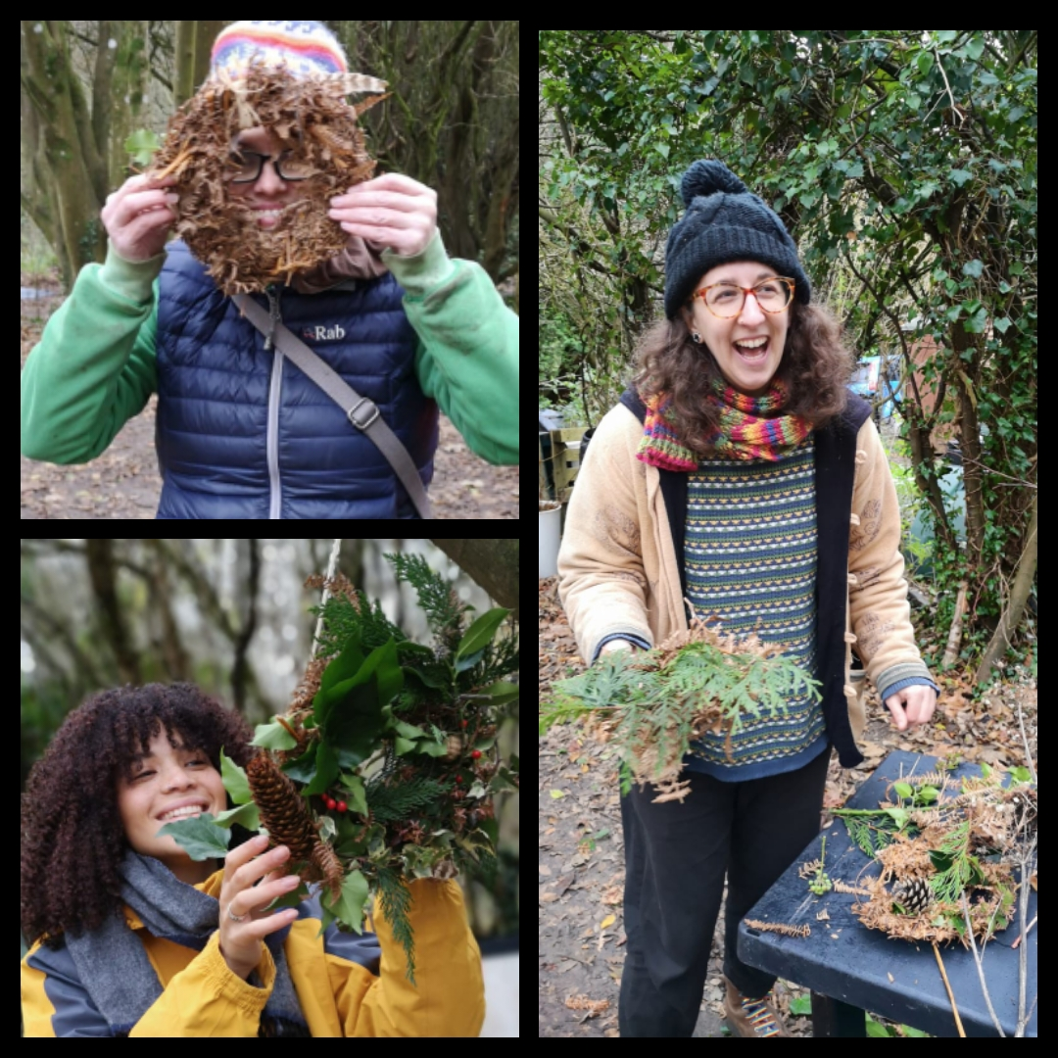
Care – to be a well run organisation with happy and motivated staff and volunteers and to take environmental and ethical responsibility
Efforts to tackle plastic waste slightly hindered by pandemic and need for PPE!
Working with partners across Surplus Food Network and Brighton Compost Club to introduce compost tumblers
17 people on payroll + team of sessional staff and freelancers
75-100 volunteers at any one time. Inc Board – 13 volunteers – thank you!
Paid Internship Scheme with University of Sussex
Tough year – moved to online communications as a team, now returning to the office

Slide 13
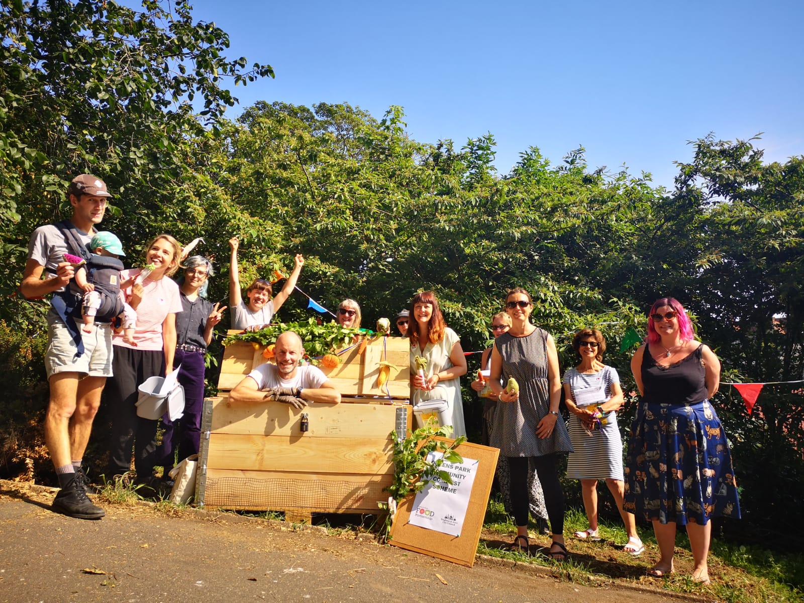
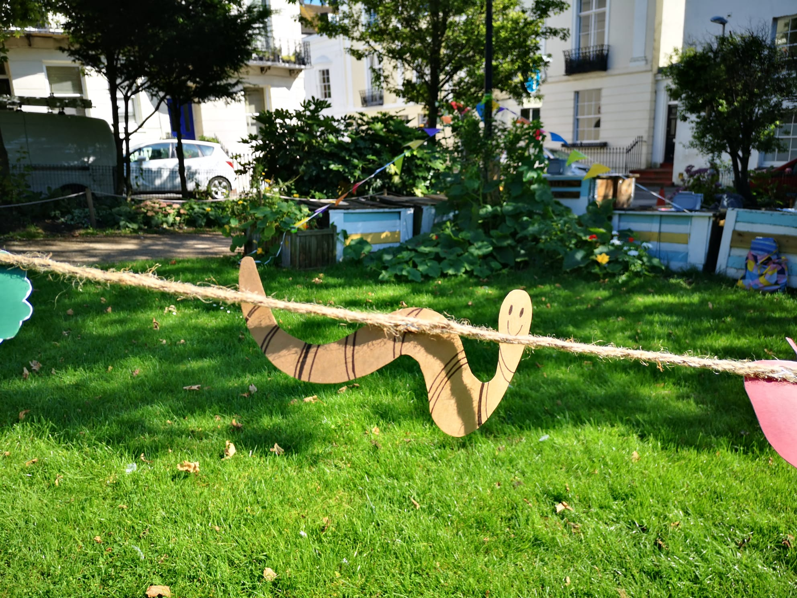
Community Composting – 10 years – hundreds of volunteer compost monitors

Slide 14
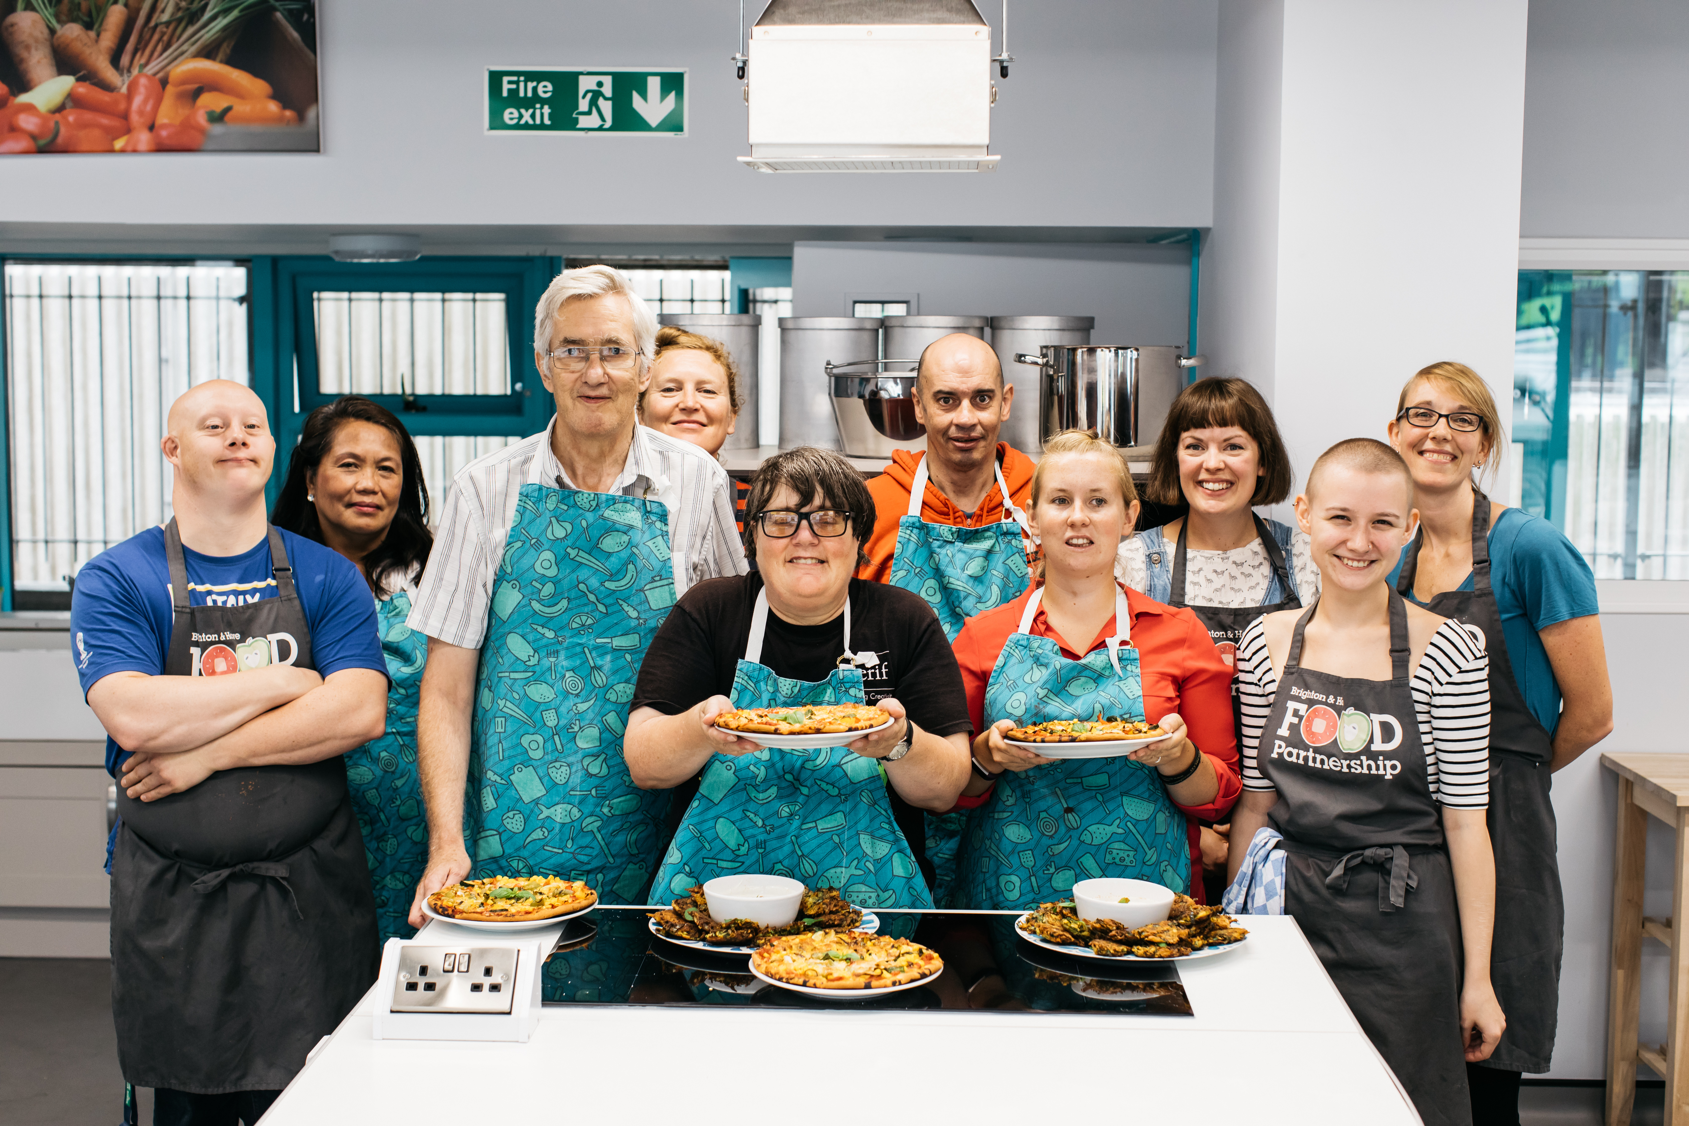
Climate Day of Action – 29th September
Climate Day of Action
Whether you are an individual eating lunch solo or an organisation serving food, you can join in on a National day of Action on 29th September by organising a ‘low carbon lunch’.
Post a photo of your low carbon lunch on social media and tag @btnhovefood and #LowCarbonLunch #Food4Planet #FoodPartnership

Slide 15
Questions?

Slide 16
Annual Account 2020/21
Have been prepared by Taylorcocks Accounts
Being presented by Vic Borrill but Sue Paskins and Ollie Sykes (joint Treasurers) can answer questions.

Slide 17
Income and expenditure summary
Page 4 | 2020/2021 | 2019 / 2020
Income | 961,315 | 477,180
Expenditure | 955,463 | 477,394
Difference | 5,825 | (214)
Accounts reflect role BHFP played in Covid-19 Emergency Food Response. £520,000 of income / expenditure in 20/21 was for this work
Includes BHFP’s Emergency Food Hub, Grants and food to Food Banks / Meal Projects, establishing 7 Affordable Food Projects
Small in year surplus £5,825 which has been added to reserves
Have been advised no corporation tax due this year as no profit on taxable income (traded)

Slide 18
Sources of income
Fee / rent income reduced as Community Kitchen closed
Furlough (in misc income) and BHCC business interruption grants helped when not able to trade
Grants / crowdfund / donations income increased from £336,048 in 2020 to £896,312 in 2021

Slide 19
Grants and donations
45 different grant sources - included local and national government funding, Big Lottery, trusts
Donations from individuals and local businesses – Hungry at Home campaign
Funders such as Fonthill Foundation and Esmee Fairbairn Foundation flexible with funding
Worked hard to re-open projects eg gardens as quickly as possible
Thank you to everyone who gave to us

Slide 20
Expenditure p15
Difference to 2020 due to changed nature of work during crisis
17 people paid via payroll + freelance tutors / HR consultant and book-keeper
Rent reduced by Community Base during lockdown (+have less space than in 2020)
BHFP always plays a lead partner role – commissioning partners to deliver work /giving small grants. Total £211,822 of which 70% was for Covid-19 work. Other Green Wellbeing Alliance, Food Factory Brexit contingency grant and food waste work with SCDA

Slide 21
Deferred income – Total £172,002
Where funding was given at the end of the FY 20/21 for work in 21/22 or where work was delayed due to Covid-19 we have deferred grants.

Slide 22
Questions?
Would someone propose and second that the AGM recommends that the Board of BHFP adopts these accounts

