Slide 1
AGM 2022
20.09.22 Vic Borrill

Slide 2
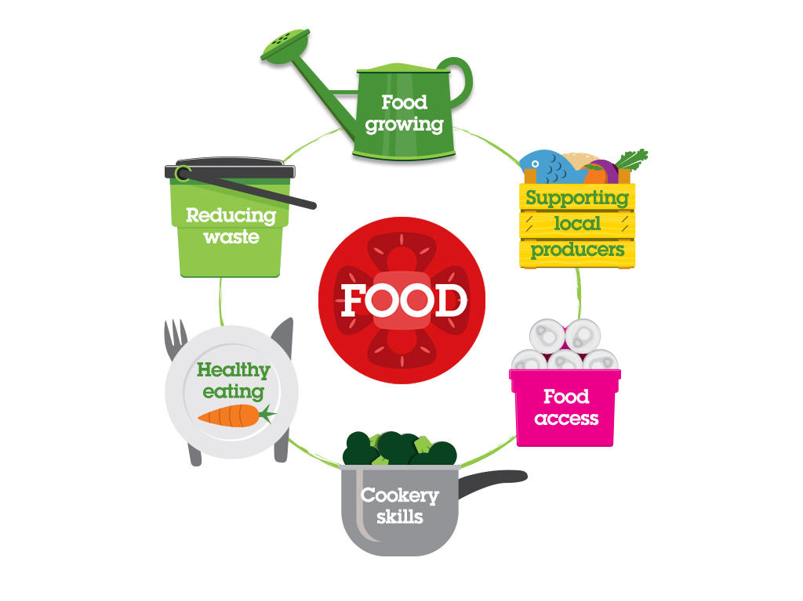
Brighton & Hove Food Partnership
BHFP is an independent, ‘not for profit’ established in 2003 that helps people learn to cook, to eat a healthy diet, to grow their own food and to waste less food.
Work with individuals
Work with groups
Work with caterers and food businesses
Work at a strategy and policy level

Slide 3

Our work
Our aims:
Connect – to be a hub and network builder
Inspire – to inspire, support and encourage people to adopt healthier, more sustainable diets and lifestyles
Champion – to champion and support community led food projects
Influence - to influence the behaviour of large organisations
Lead – to operate at a strategic level.
Care – to be a well run organisation with happy and motivated staff and volunteers and to take environmental and ethical responsibility

Slide 4
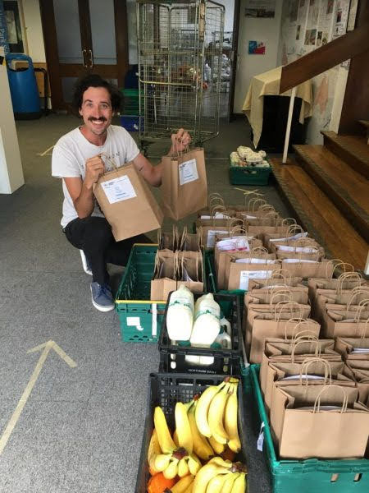
2021/22 – a year of transition
Whilst significantly less than 2020/21 still involved in city’s emergency food response.
Ensure that food support continued where needed and where temporary provision was closing this was done in a well-planned way
Bulk purchasing and In The Bag
Administered grants from BHCC (£100K+ given out to 30 groups)
Food Cell approach continued with BHCC

Slide 5
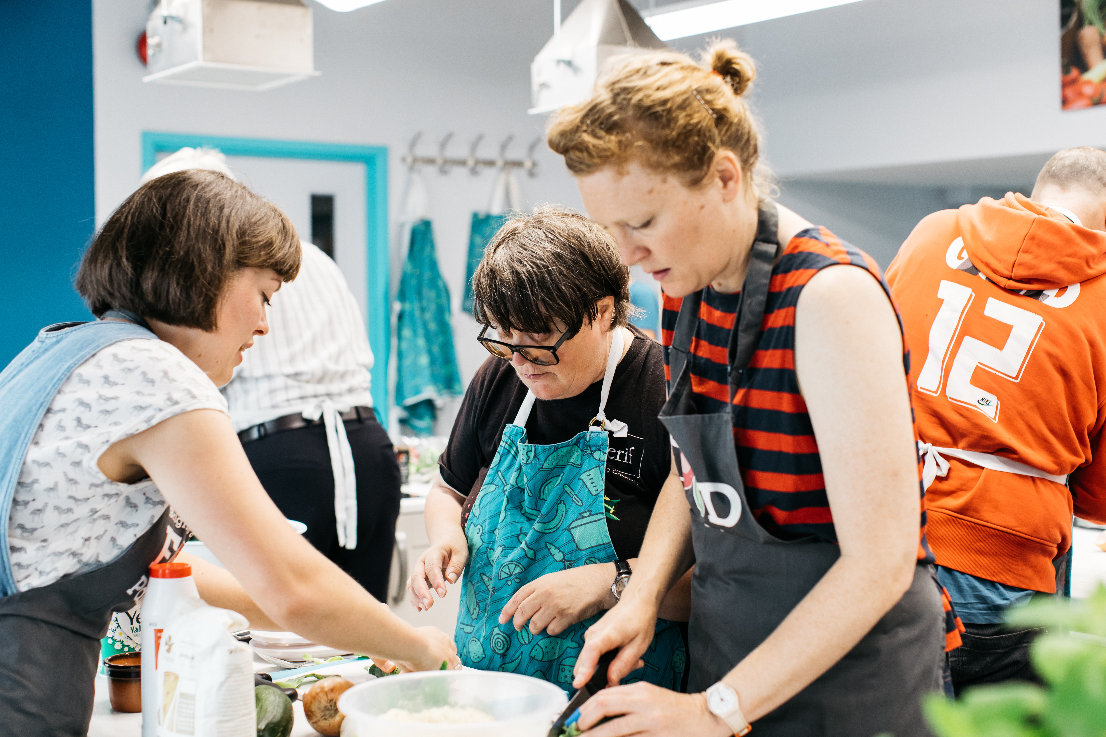
Community Kitchen
Re-opened – various restriction re social distancing / limited numbers managed
Rebuild the social business – evening / weekend classes and parties/ events and hires
Community classes including Jumpstart and Food Foundations
Schools work

Slide 6

Hub for information, connection and inspiration
Refreshed website
Fortnightly newsletter and social
Fundraising campaign with Citizen’s Advice
First point of contact on phone email including for people in poverty needing food

Slide 7
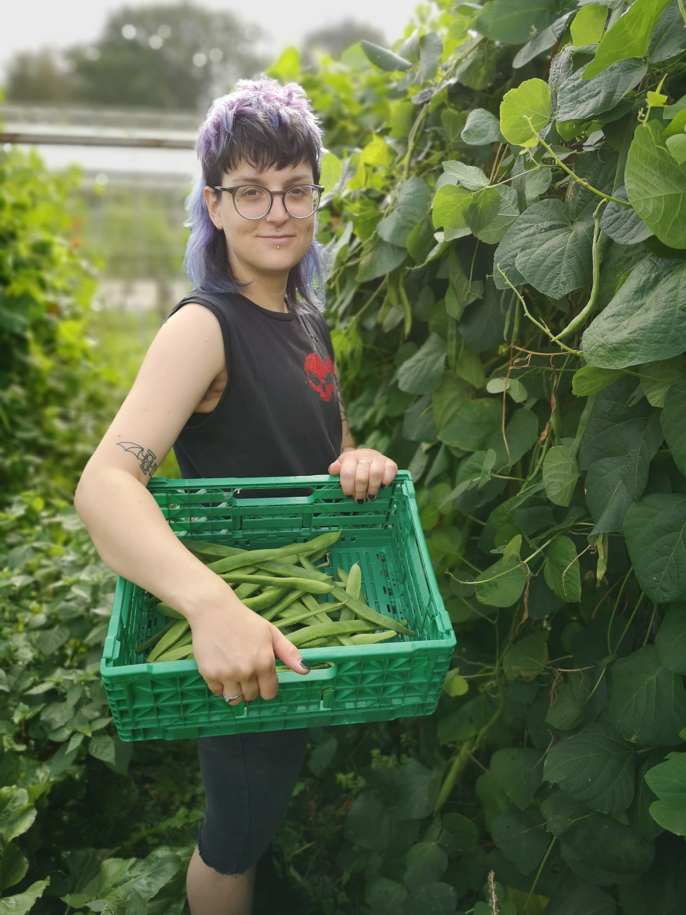
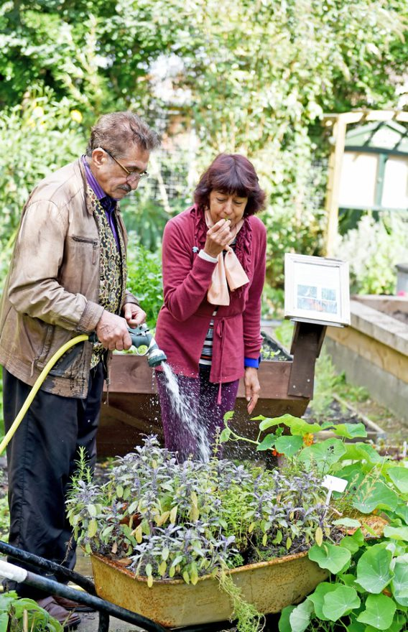
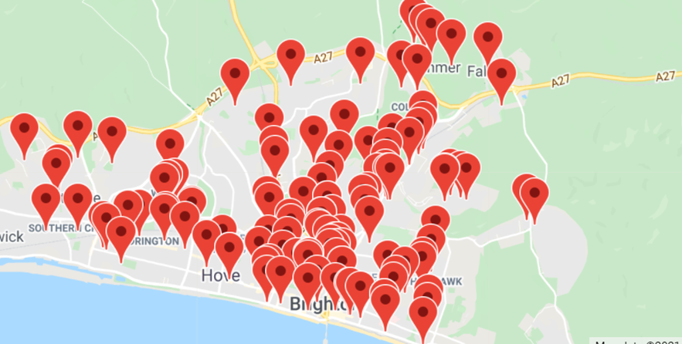
Work with community led food projects
Surplus Food Network
Emergency Food Network
Affordable Food Projects
Shared meal projects
Community food growing spaces
Rock Farm visits – Farming the Future

Slide 8

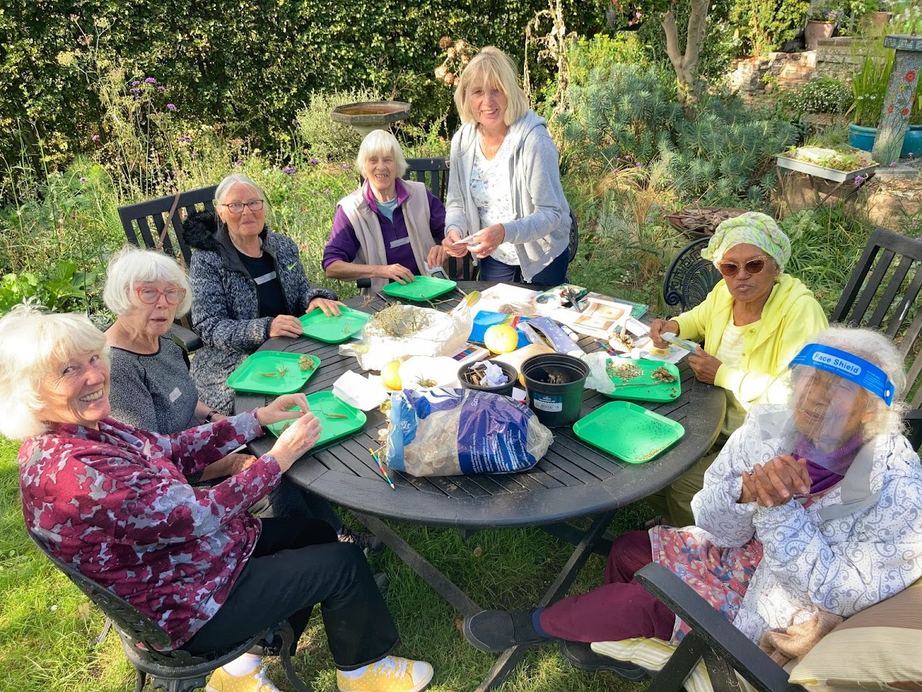
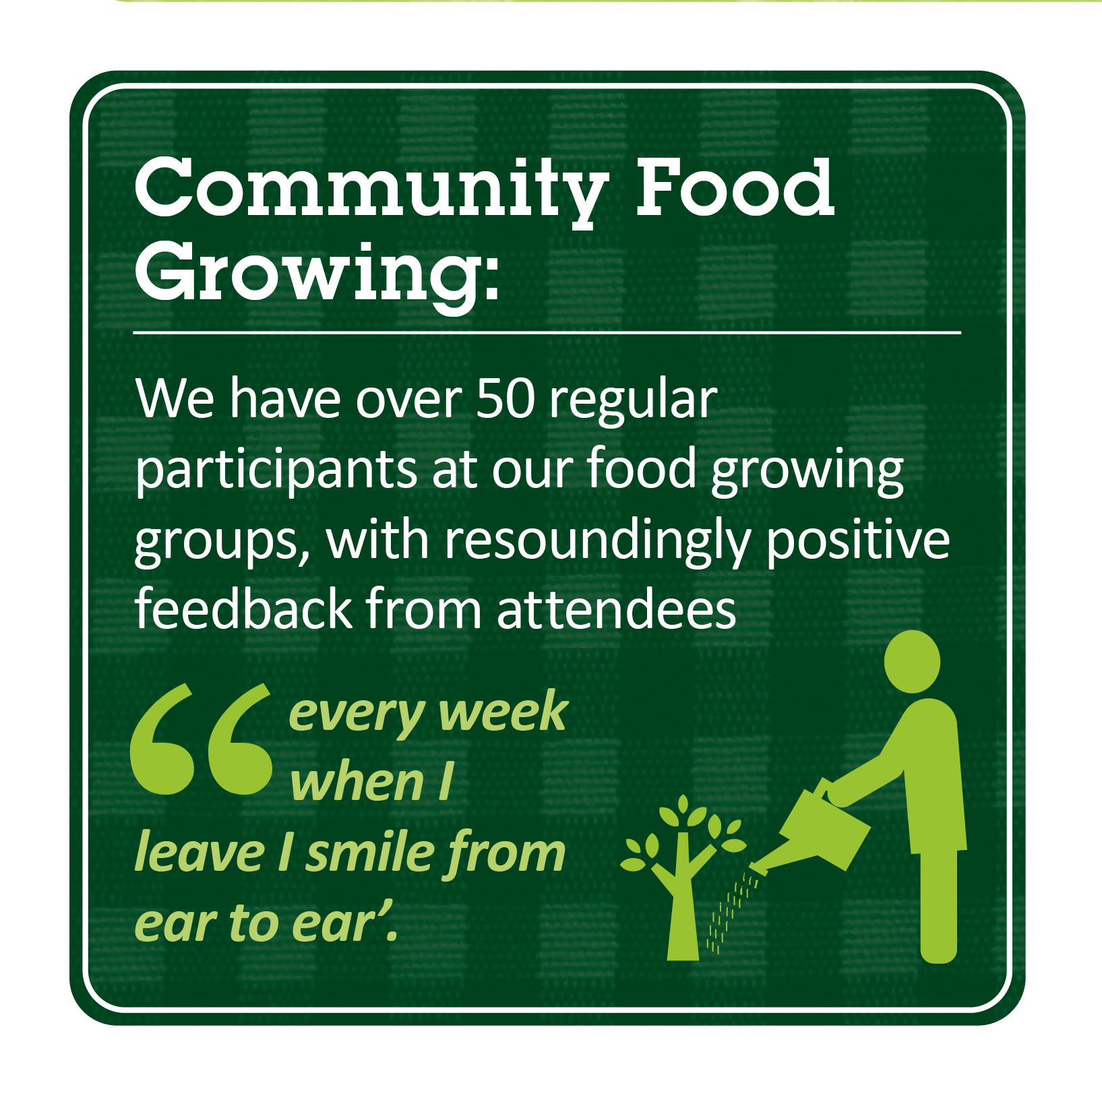
Gardens
Dementia Gardening Preston Park and Saunders Park food growing spaces
Green Wellbeing Alliance
Changing Chalk Project

Slide 9
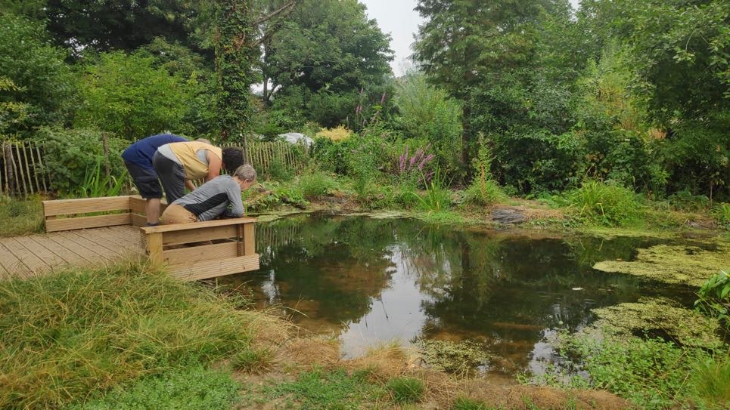

Stanmer Wellbeing Gardens
Restored Pond at Stanmer Wellbeing Gardens

Slide 10
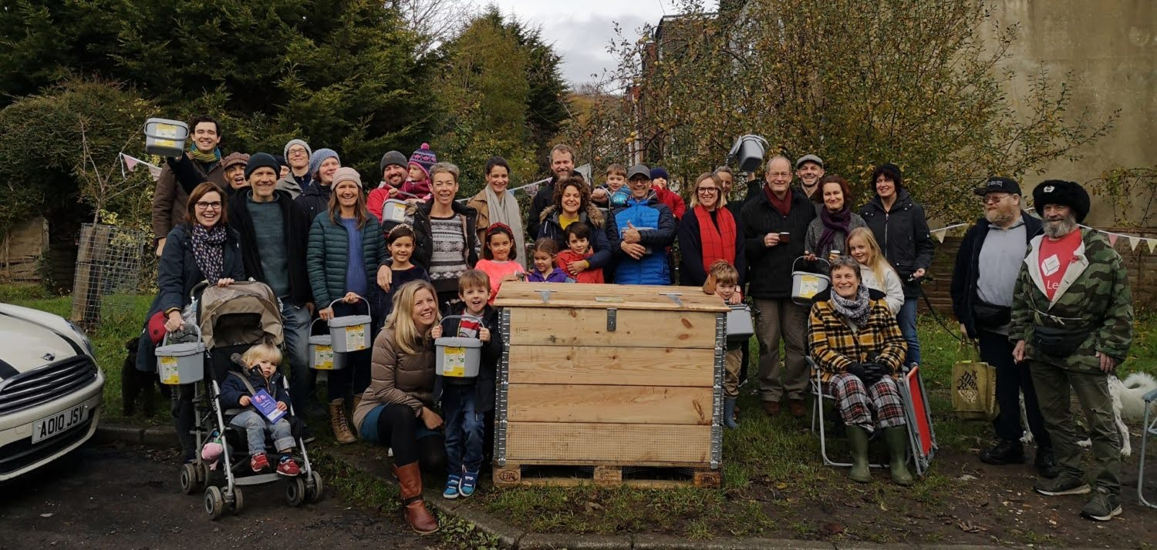
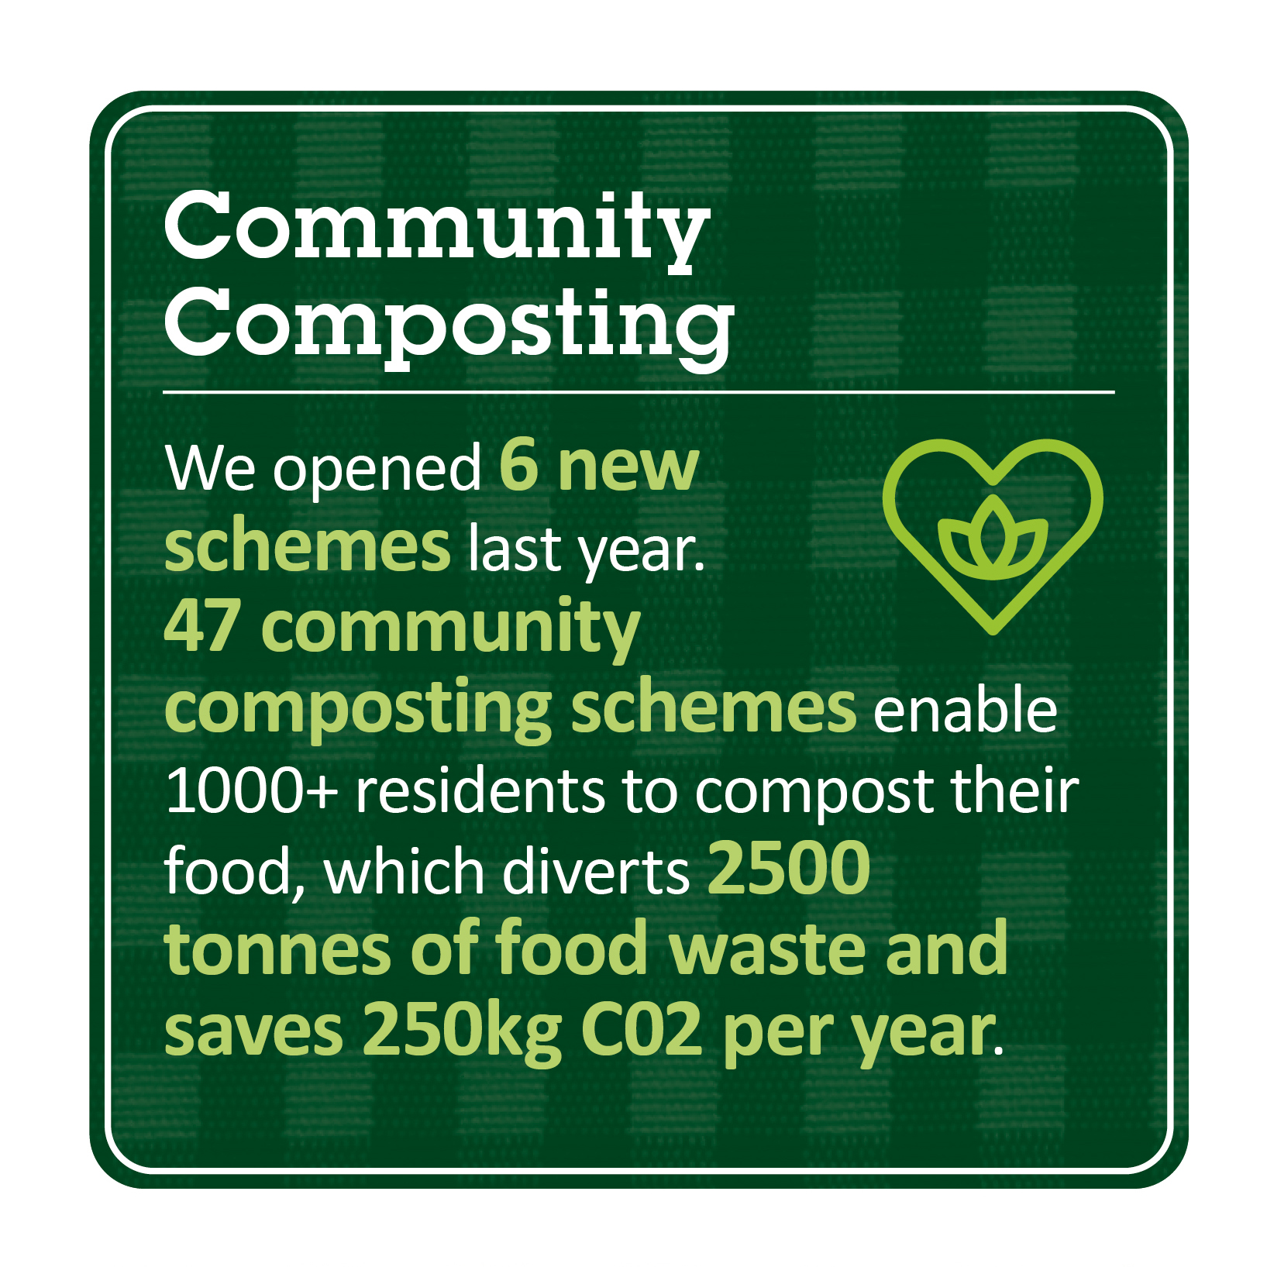
Community Composting
Now expanding to include compost tumblers

Slide 11
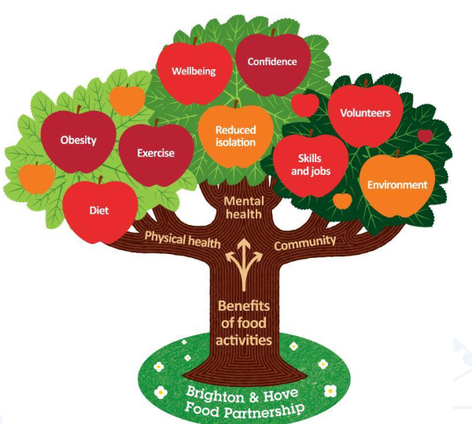




Lead – to operate at a strategic level. Lead city’s Food Strategy and advocate using food as a policy tool to achieve health, wellbeing and sustainability outcomes. Share our experiences nationally and internationally.

Slide 12

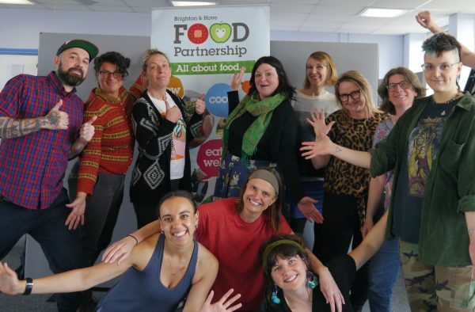
Be a well run organisation with happy and motivated staff and volunteers and to take environmental and ethical responsibility
22 people on payroll + team of sessional staff and freelancers
150 volunteers at any one time. Inc Board –thank you!
Paid Internship Scheme with University of Sussex
Waste audits – new compost tumbler.

Slide 13
New work
Big Lottery Climate Action Fund Project – Food Use Places and Compost Tumblers in 8 locations
Cost of Living Crisis – an average of more than 5,000 people used Network members’ services every week. More than 3,000 people used these services on an ongoing basis. Campaigns at local and national level
Esmée Fairbairn Foundation – Land Use Plus project

Slide 14
Questions?

Slide 15
Annual Account 2020/21
Have been prepared by Taylorcocks Accounts
Being presented by Vic Borrill but Sue Paskins and Ollie Sykes (joint Treasurers) can answer questions.
Chance for questions
Accounts will be signed off at the next FP Board meeting (October) and filed with companies house

Slide 16
Income and expenditure summary
Page 5 | 2021/22 | 2020/2021 | 2019 / 2020
Income | 819,803 | 961,315 | 477,180
Expenditure | 817,907 | 955,463 | 477,394
Difference | 1,896 | 5,825 | (214)
Although turnover reduced since 2020/21 still £220,000 of income / expenditure associated with emergency food. Not part of our usual activity
There may be a small amount of corporation tax due this year – TaylorCocks will calculate before accounts signed off

Slide 17
Sources of income
Fee / rent income returned as Kitchen re-opened
Grants / crowdfund / donations income continued to form majority of income
BHCC and the Big Lottery continue to provide significant investment

Slide 18
Deferred income
Funding that was given at the end of the previous FY for work in 22/23
Upfront payments for work across two FYs
Multi year projects with work was delayed due to Covid-19 we have deferred grants with agreement of funder

Slide 19
Expenditure p17
22 people paid via payroll + freelance tutors / HR consultant and book-keeper
Role as lead partner / administering grants to smaller projects. Total value just under £180,000. 60% was to food banks / meal projects and affordable food projects

Slide 20
Questions?

