Slide 1
AGM 2024
01.10.23 Vic Borrill

Slide 2
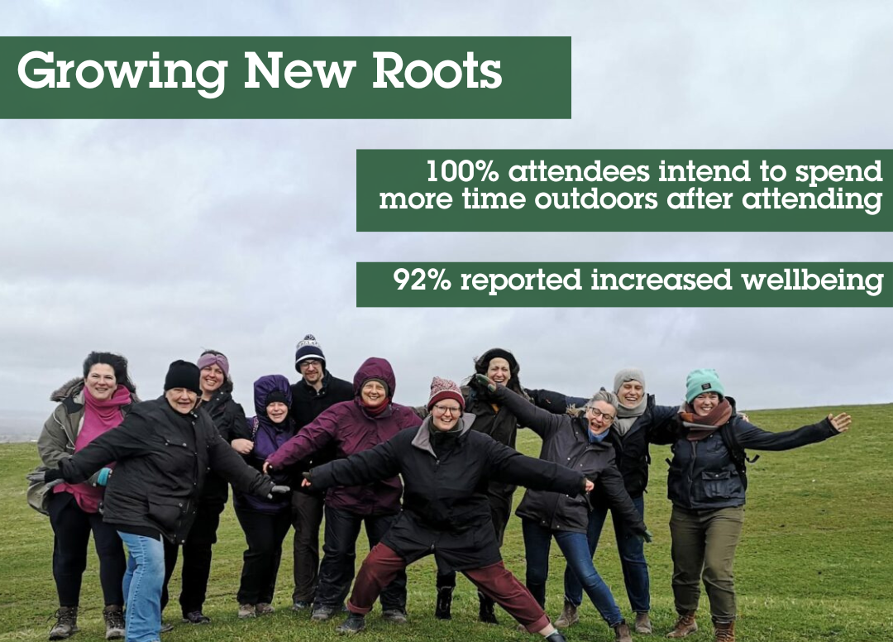
Community gardening – Stanmer, Preston Park, Demo Garden, Growing New Roots, Dementia Gardening
Stanmer – regular volunteer group, hiring space, Fonthill Foundation funded school visits
Dementia Gardening – at the Garden House
Preston Park / Saunders Park fortnightly sessions
Growing New Roots therapeutic outdoor sessions
Green Wellbeing Alliance collaboration

Slide 3
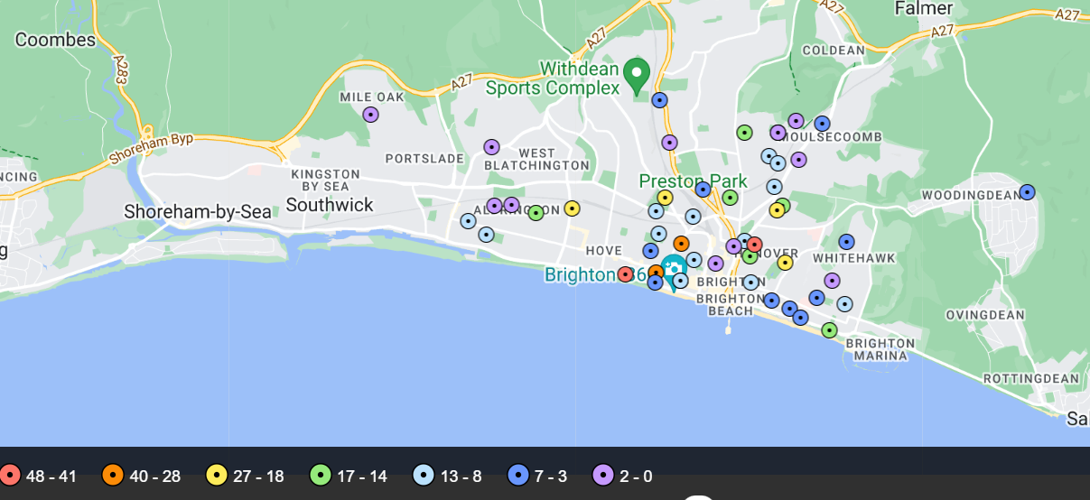
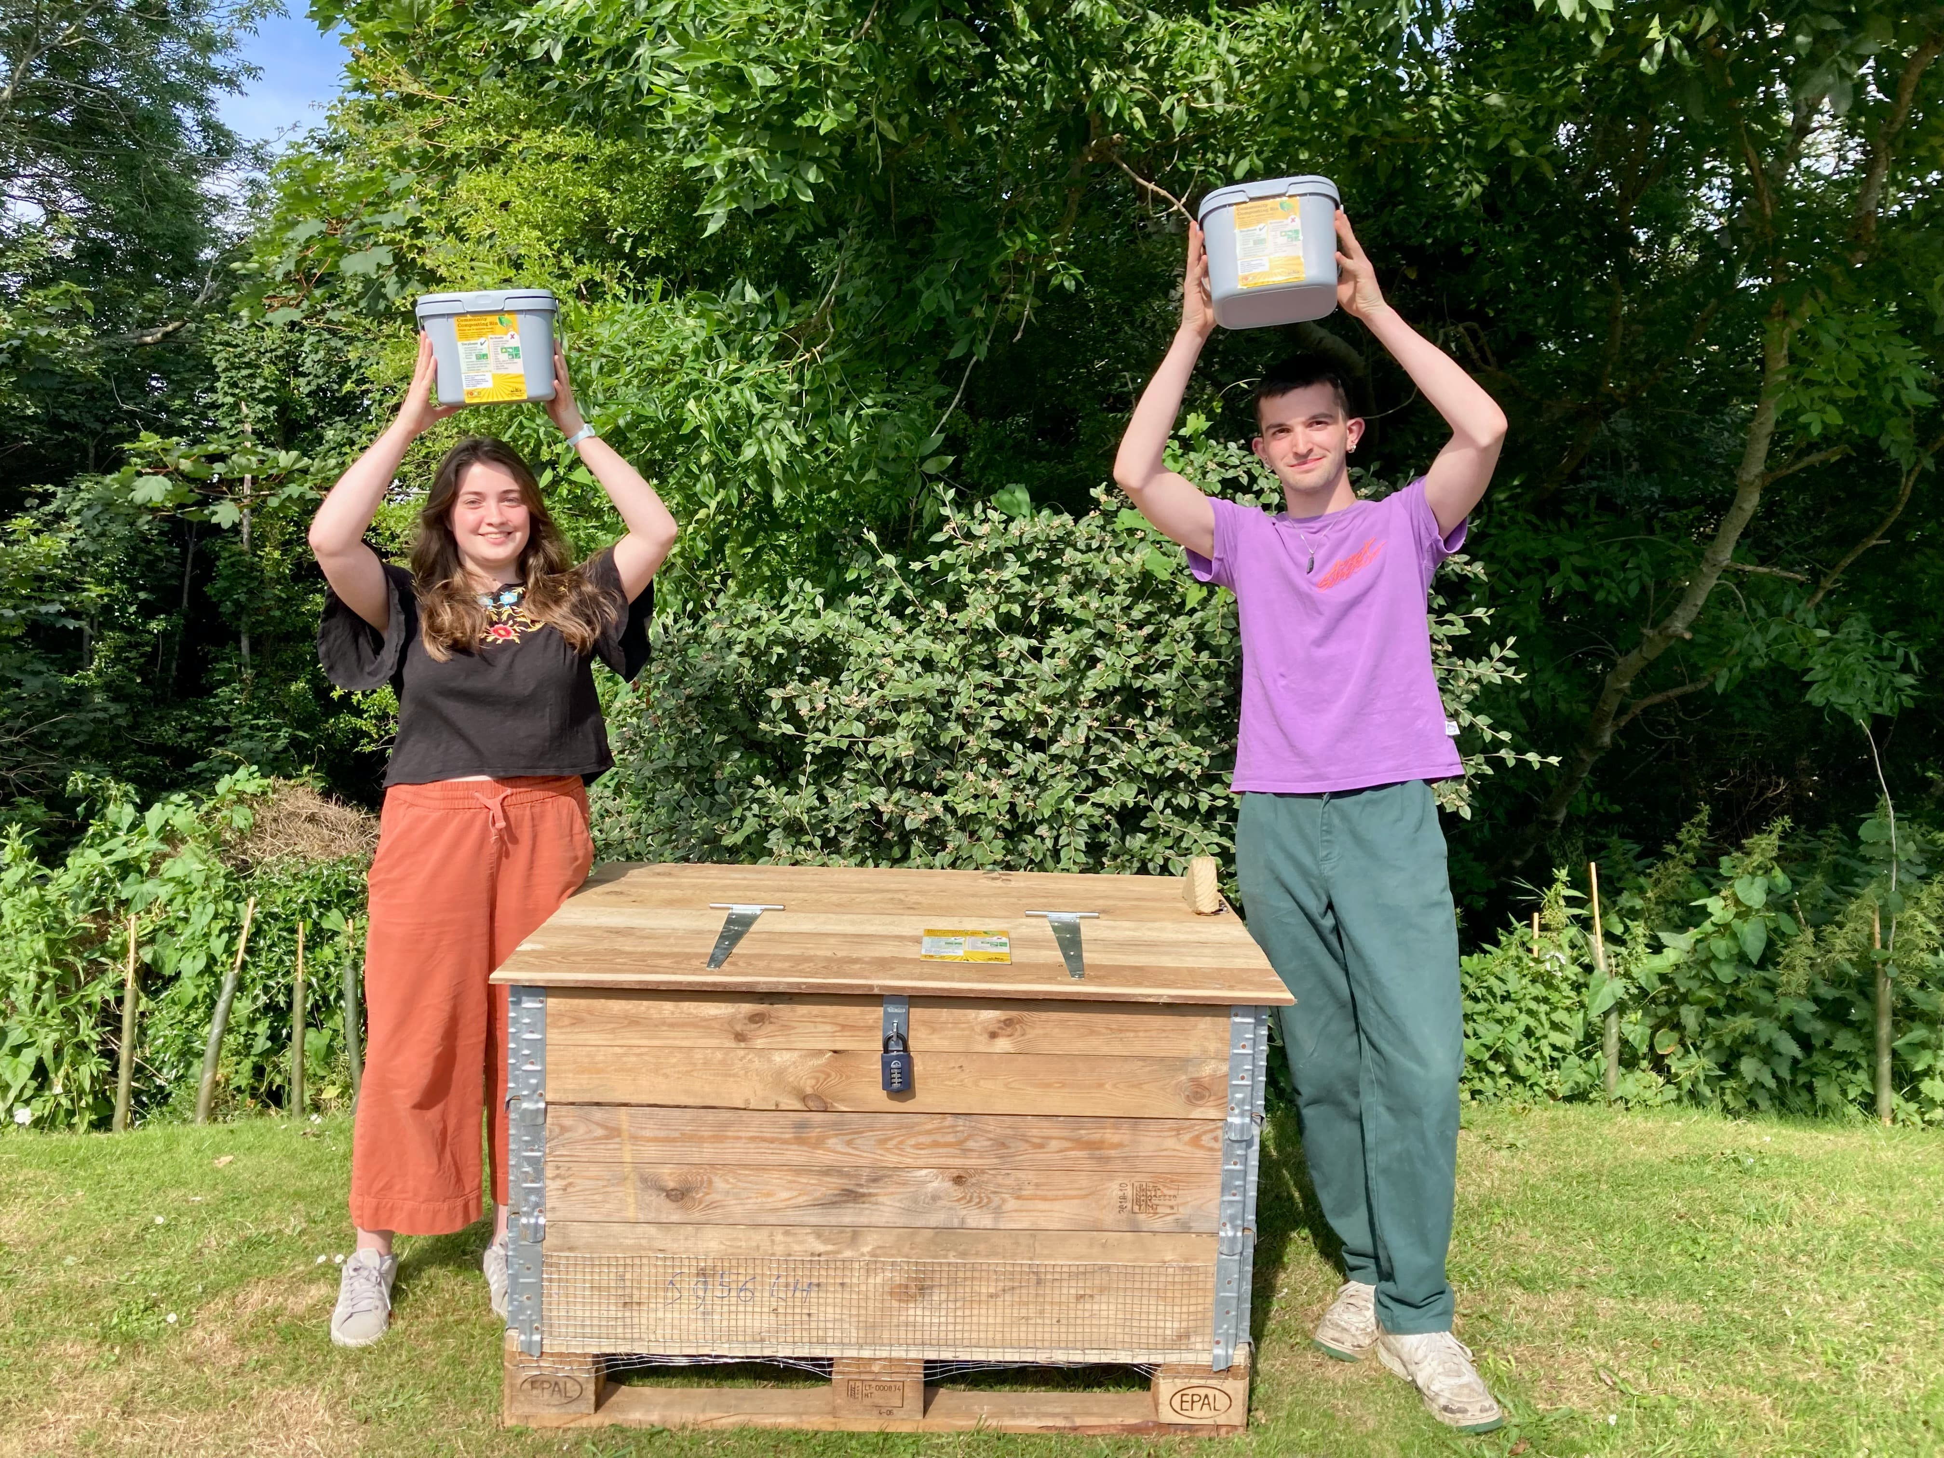
Community Composting
54 schemes – more that 1100 households
Waiting list but currently no funding for new schemes

Slide 4
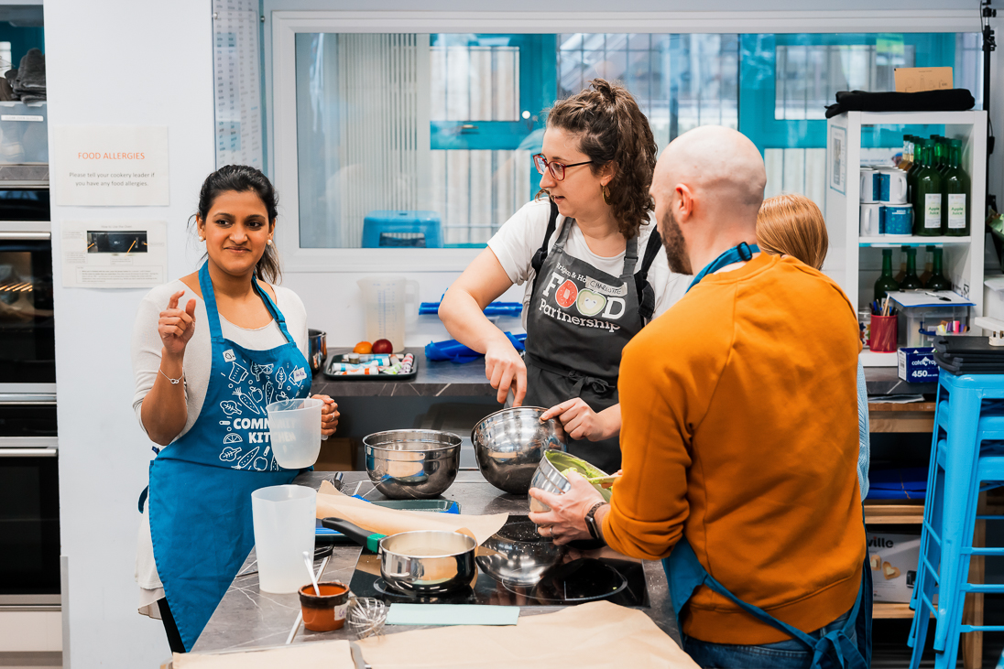
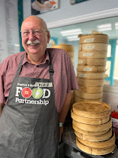
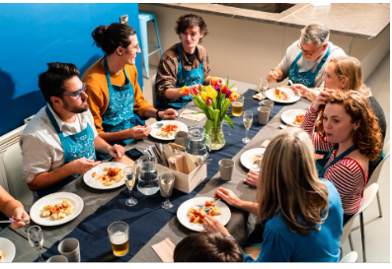

Community Kitchen - By end of 2023 15,000 meals had been shared at our dining table
Notes:
kevin

Slide 5
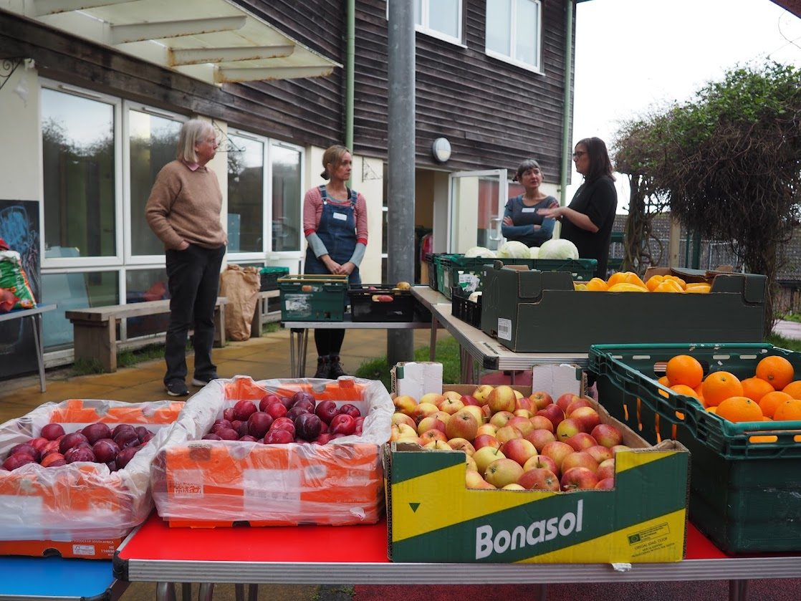
Emergency Food Network / Affordable Food Network
Network meetings
Action Learning Sets
Specific research eg into needs of people with disabilities and health conditions
Link to Brighton & Hove City Council
Food SOS
Survey

Slide 6
EFN survey results 2024
Figures are still consistent with the high level of demand reported last year ​
During one week in July 2024, 45 food projects supported around 6,300 beneficiaries
This is a similar figure to the 6,400 beneficiaries supported in 2023 but still considerably higher than the 5159 people supported in 2022.
Overall, projects reported over half of people using their services were doing so on an ongoing basis, a similar level as in 2023.
Supporting this food provision and surplus food distribution are a huge team of volunteers. Volunteers give a total of 3,412 hours each week across 40 of the projects.
Spend on food and vouchers - Across the city a total of £15,770 was spent on food and vouchers to buy food by 44 projects in a week - that's £820,040 per year. The value of this donated and surplus food is not included in this spend figure.

Slide 7
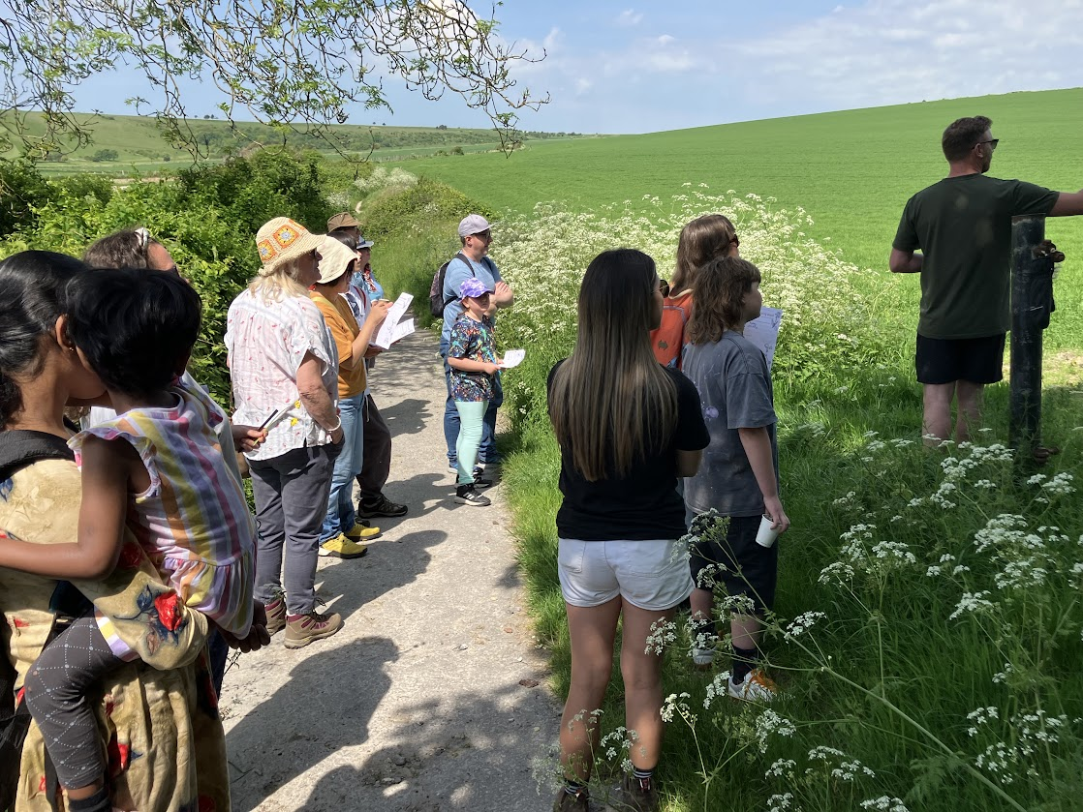
Land use, farming, local supply chains and connecting city people to food production
Land Use Plus a joined-up approach to land use whereby food production is connected with the environment and spaces for people.
Sussex Grazed. Direct buying meat box scheme building on Sheepshare project.
Soil in the City Opportunities for members of Affordable Food Projects to visit farms

Slide 8




Being part of a national and international research and partnerships
FoodSEqual. UKRI project. 4 different cities (Brighton, London, Reading, and Plymouth). Community Researchers. Fed into food strategy action plan refresh
EdiCitNet – finished including contributing podcasts and films to their learning resource
Cultivate – UKRI funded programme led by
Dublin University about Food Sharing Initiatives

Slide 9
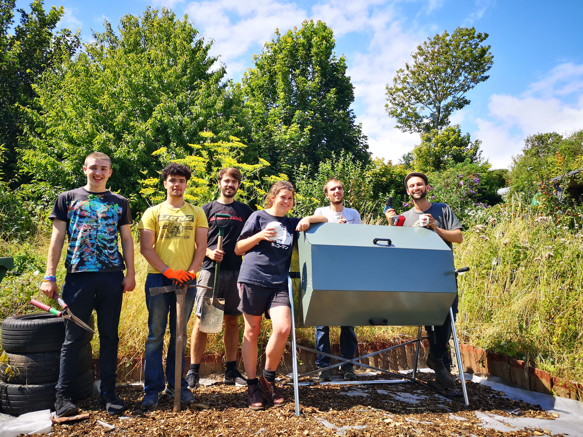
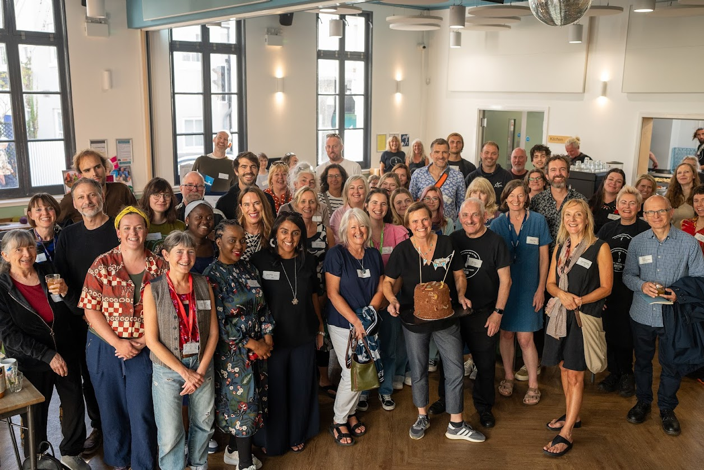
Food Use Places – secured funding for 4 years work from Climate Action fund

Slide 10
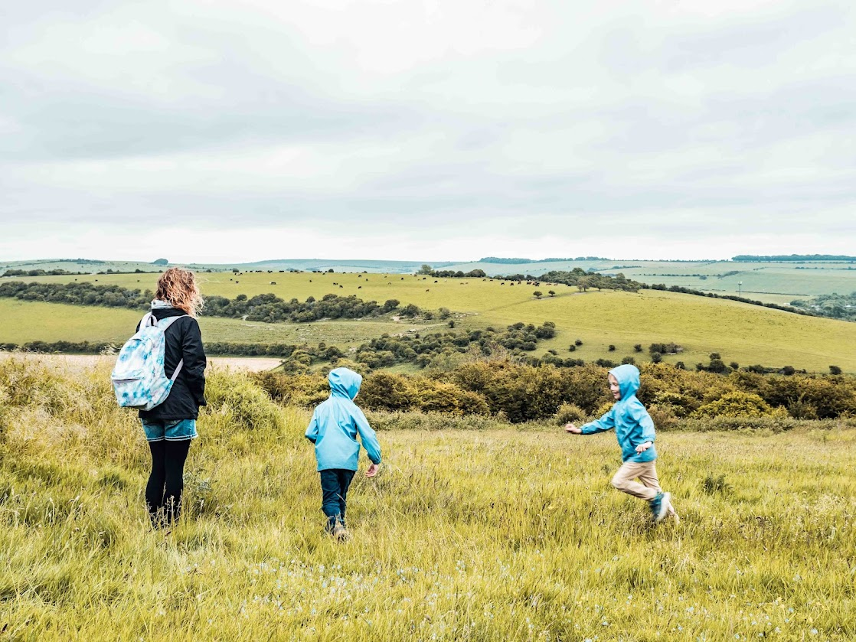
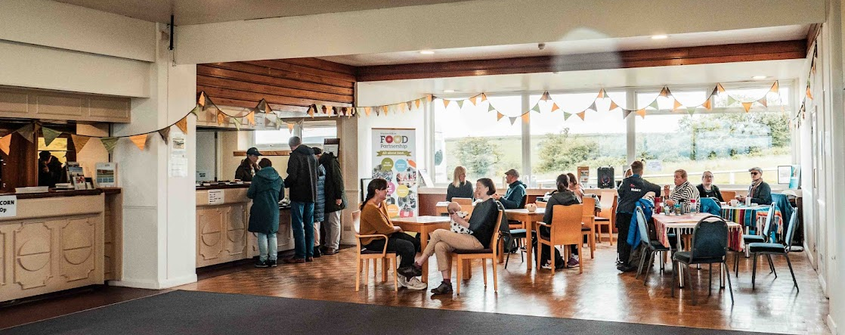
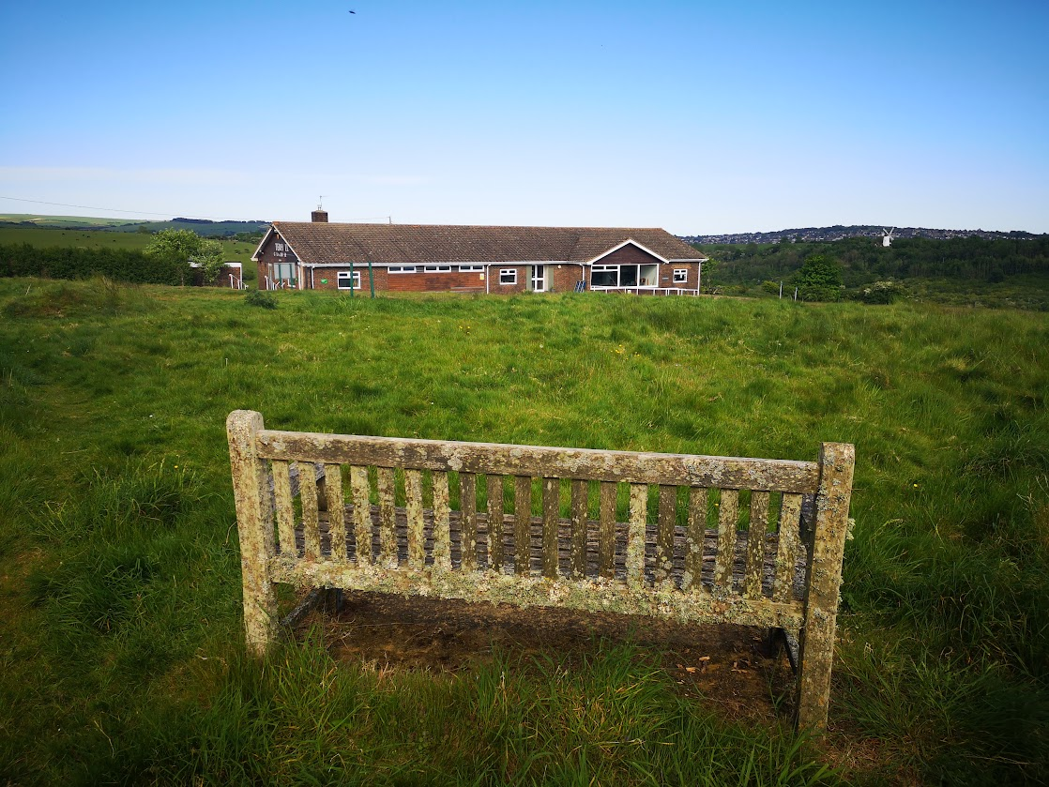
The Clubhouse at Waterhall

Slide 11

Food Strategy Action Plan refresh

Slide 12
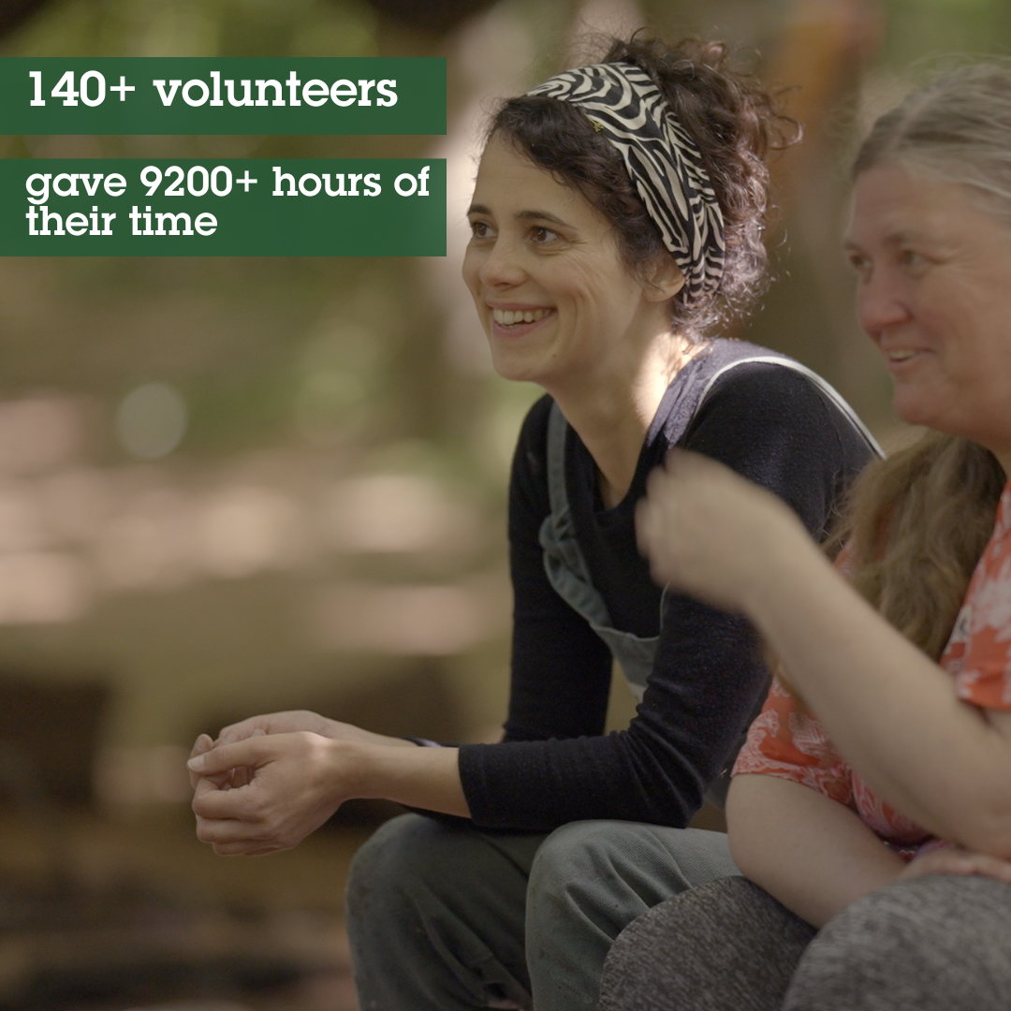

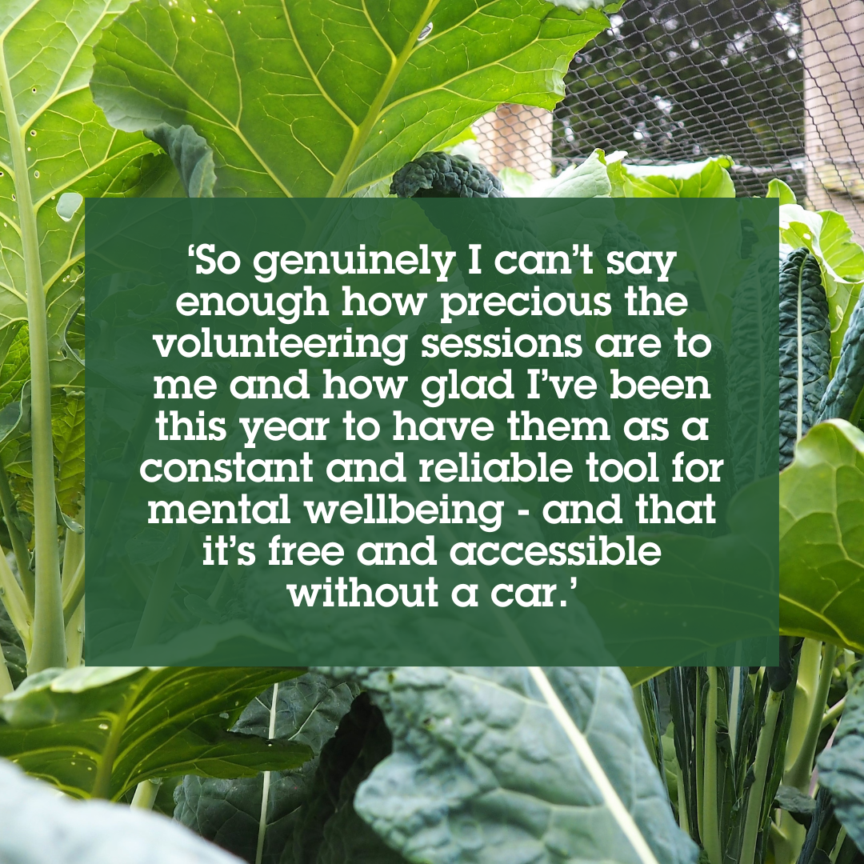

Staff and volunteers
28 people on payroll + team of sessional staff and freelancers
140 volunteers at any one time. Inc Board –thank you!
Paid Internship Scheme with University of Sussex
Ongoing work to improve re equality diversity and inclusion

Slide 13
Annual Accounts 2023/24
Have been prepared by Taylorcocks Accounts
Being presented by Vic Borrill.
Chance for questions
Accounts will be signed off at the next FP Board meeting (16th October) and filed with companies house by the accountants

Slide 14
Income and expenditure summary
Page 6 | 2023/24 | 2022/23 | 2021/22
Income | 967,366 | 1,060,875 | 819,803
Expenditure | 969,715 | 1,053226 | 817,907
Difference | (2,349) | 7,649 | 1,896
Small in year loss
There is no corporation tax due
Turnover has decreased by £93K from 2023 to 2024
In 23/24 we had a high amount of additional funding for cost of living support including Household Support Fund

Slide 15
Sources of income
Grants / crowdfund / donations income continued to form majority of income. If you take out the emergency food grant funding (because it skews the picture) the proportion of our income from grants in 2023 was 78% and in 2024 it is 75%
Rent / fee income is 16% (it was 13% last time)
BHCC and the Big Lottery continue to provide significant investment

Slide 16
Deferred income - p12
Funding that was given at the end of the previous FY for work in 23/24
Upfront payments for work across two Financial Years
Amount being deferred to 24/25 = £57,212

Slide 17
Expenditure
Staff continue to be our largest area of expenditure with 58% of our expenditure related to staff costs
28 people paid via payroll (includes staff on timesheets and contracted hours)
Also freelance tutors / HR consultant and book-keeper

Slide 18
Expenditure
Role as lead partner / administering grants to smaller projects. The total amount of funding passed to other community organisations in the city was £126,297. So 13% of our income
Note 8 on page 15 sets out income and expenditure by work areas.

Slide 19
Questions?

Slide 20
Food Strategy themes – have your say
Process identified 7 key themes
Using dots you get 4 votes to say what you think is the priority
Don’t put all your dots on the same thing!

