Slide 1
AGM 2023
18.10.23 Vic Borrill

Slide 2
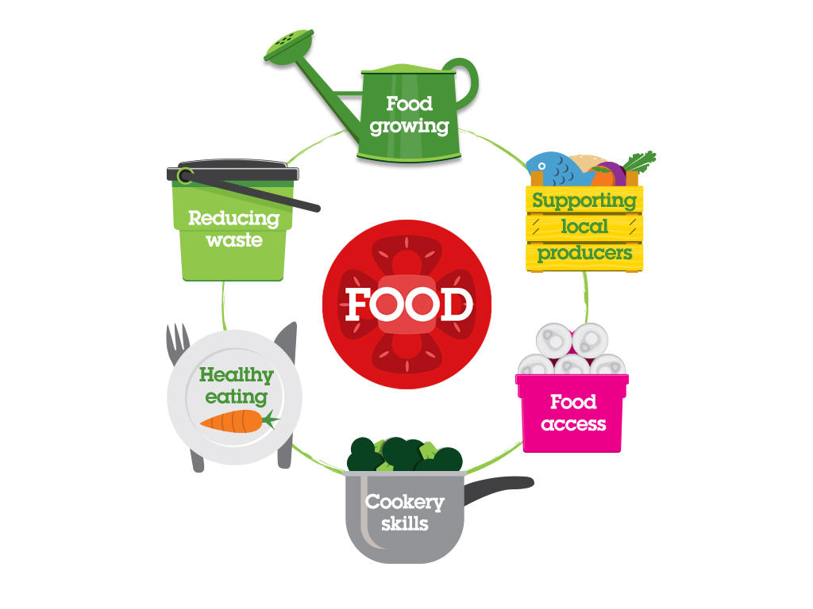
Brighton & Hove Food Partnership
BHFP is an independent, ‘not for profit’ established in 2003 that helps people learn to cook, to eat a healthy diet, to grow their own food and to waste less food.
Work with individuals
Work with groups
Work with caterers and food businesses
Work at a strategy and policy level
But it is the interconnections between these that are crucial to our approach

Slide 3
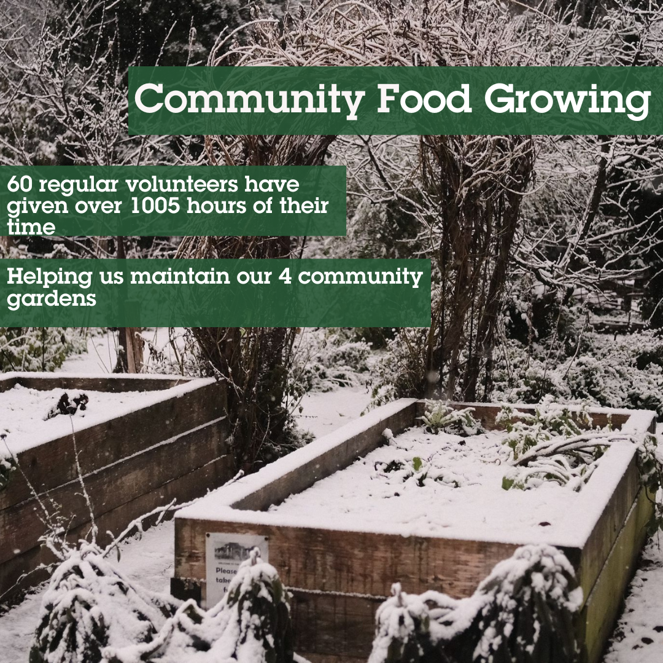
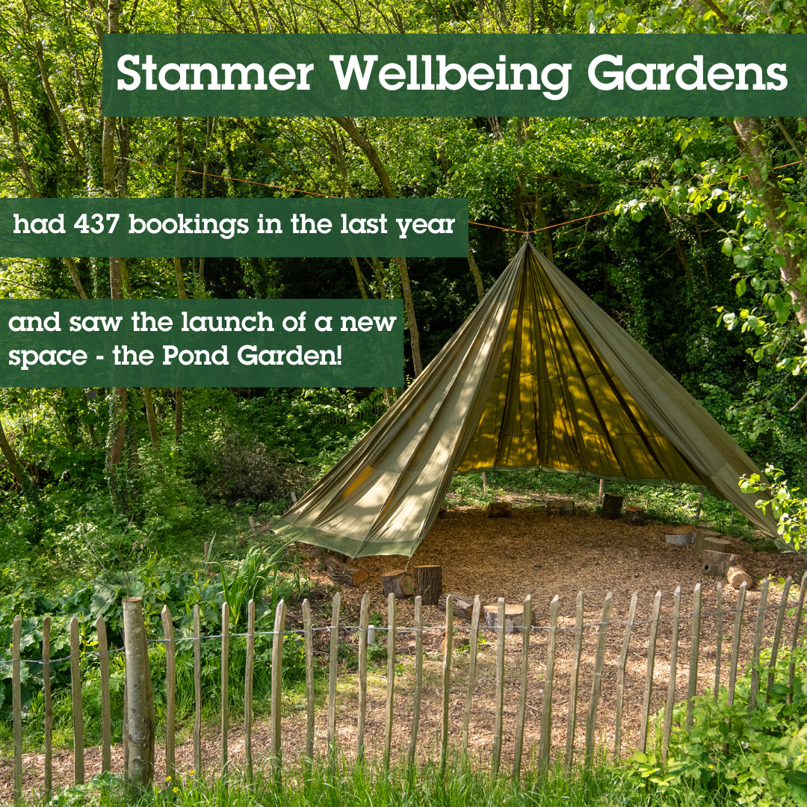
Wellbeing, food growing and nature connection
Saunders Park Edible Garden, Preston Park Demo Garden Dementia Gardening group
75% of attendees at our gardening groups report increased confidence and skills, and 68% of attendees report socialising more.
Stanmer Park – growing food for the Community Kitchen, Fonthill Foundation funded school education sessions & space rented by others
Waterhall Club House – our new venue

Slide 4
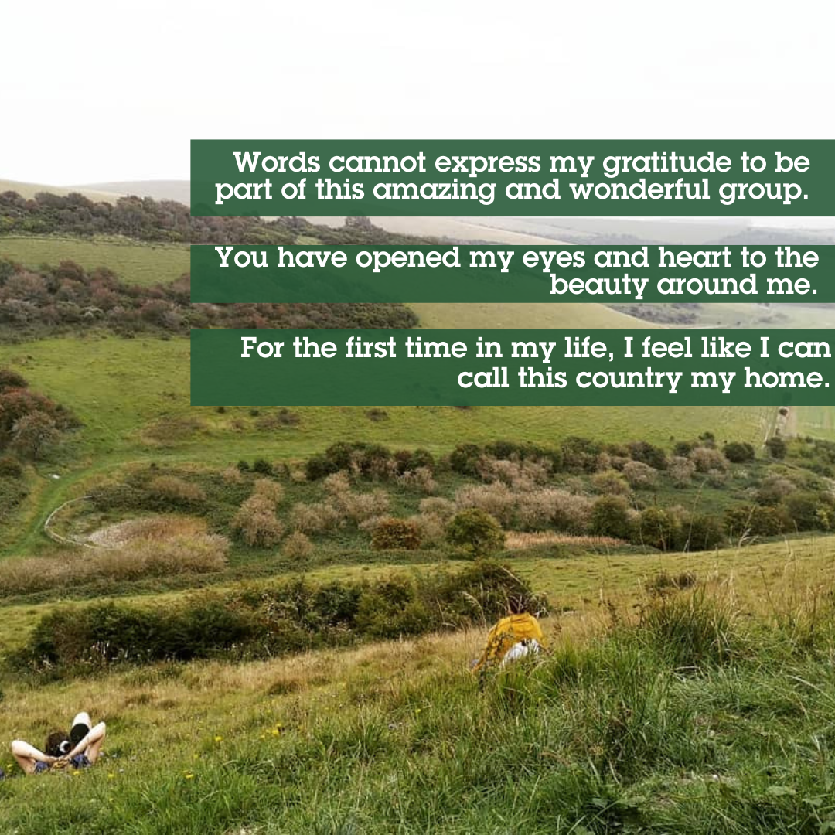
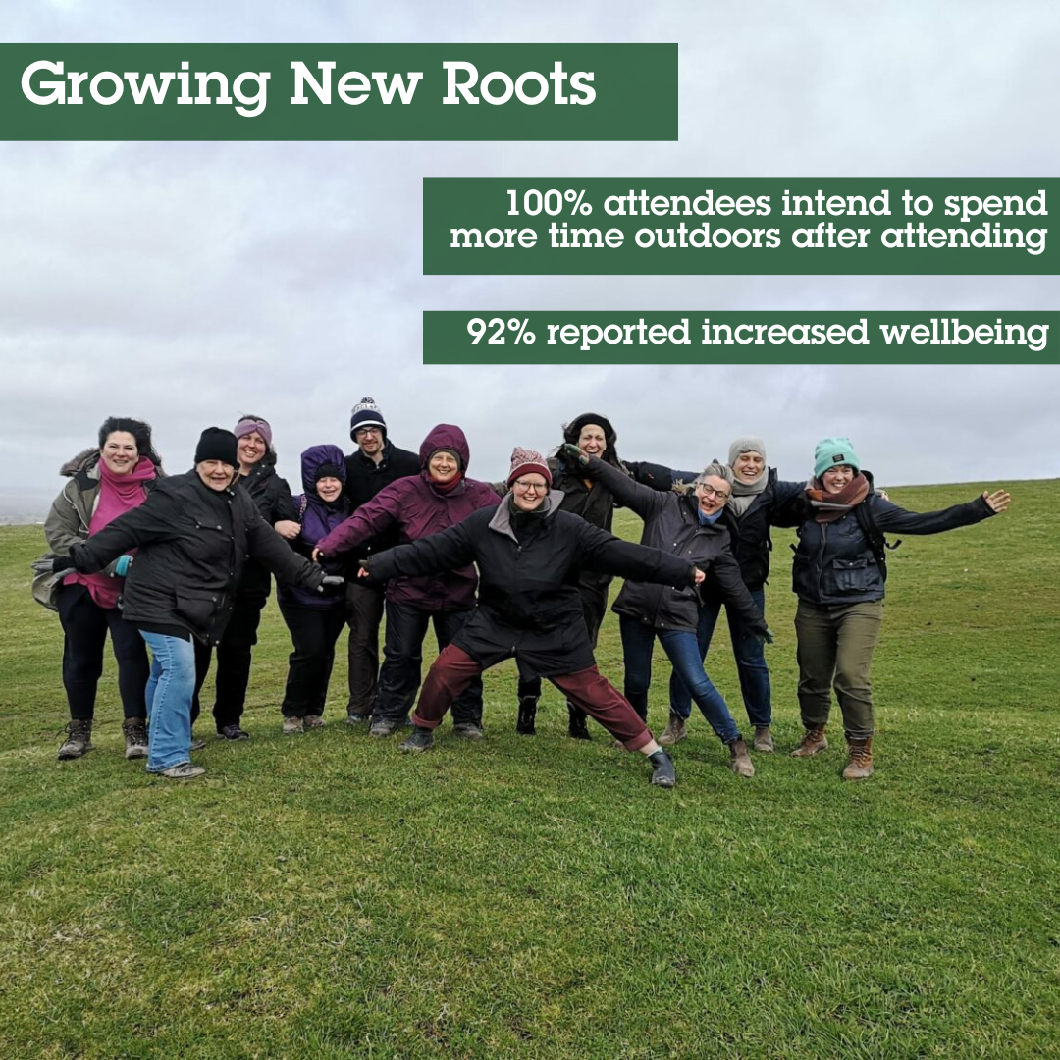
Growing New Roots

Slide 5
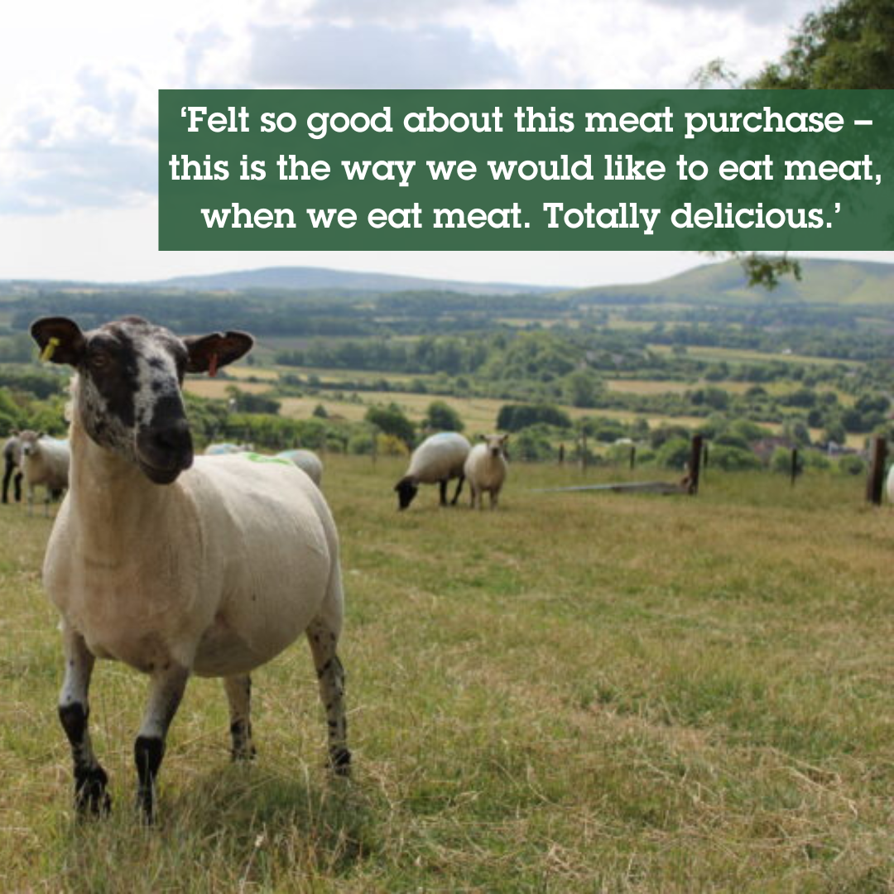
Land use, farming, local supply chains and connecting city people to food production
Land Use Plus aims to encourage nature-friendly farming; increase awareness of environmental impacts of food production; improve local supply chains and support an joined-up approach to land use whereby food production is connected with the environment and spaces for people.
Sussex Grazed. Direct buying meat box scheme building on Sheepshare project.
Soil in the City. Organising farm visits for customers of Affordable Food Projects/ Shared Meals

Slide 6
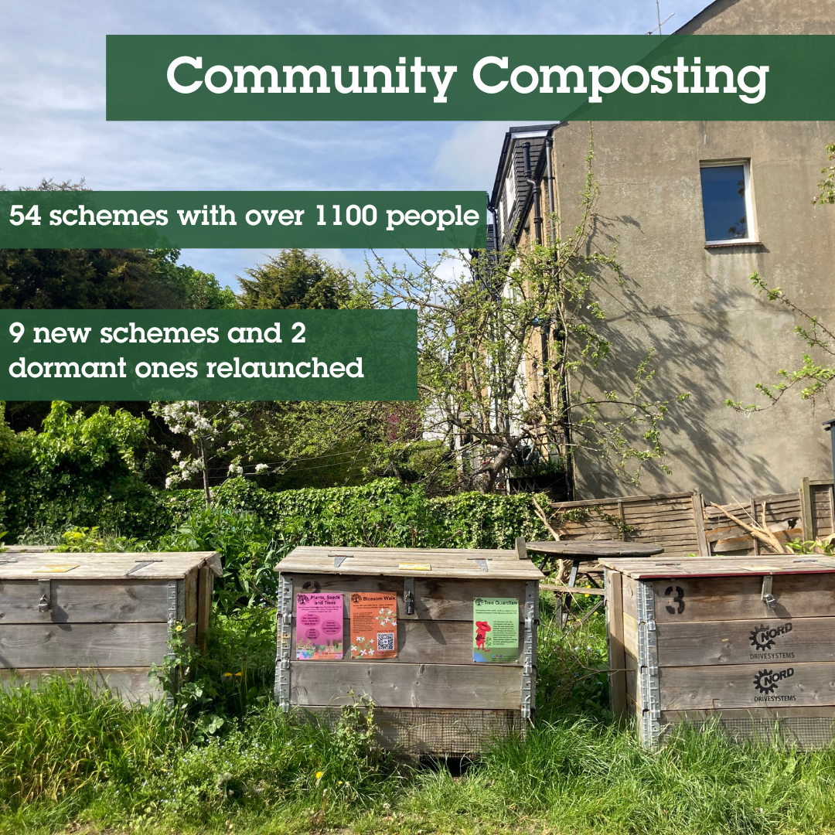
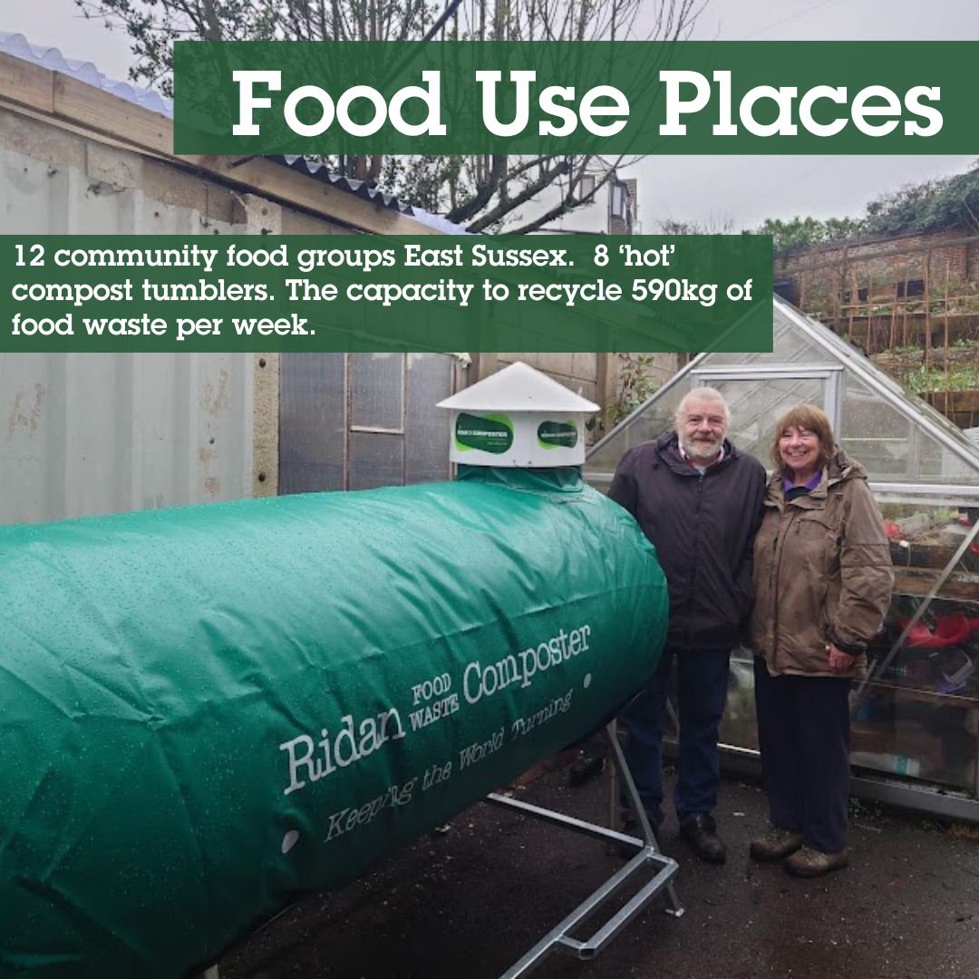
Reducing waste and creating compost
Food Use Places National Lottery Climate Action Fund Development Project. Twelve community food groups
Composting - 8 ‘hot’ compost tumblers give the capacity to recycle 590kg of food waste per week – which is the equivalent of 19 wheelie bins
11 new community compost sites
Surplus Food Network saved 1982 tonnes of surplus food
Flavour packs

Slide 7
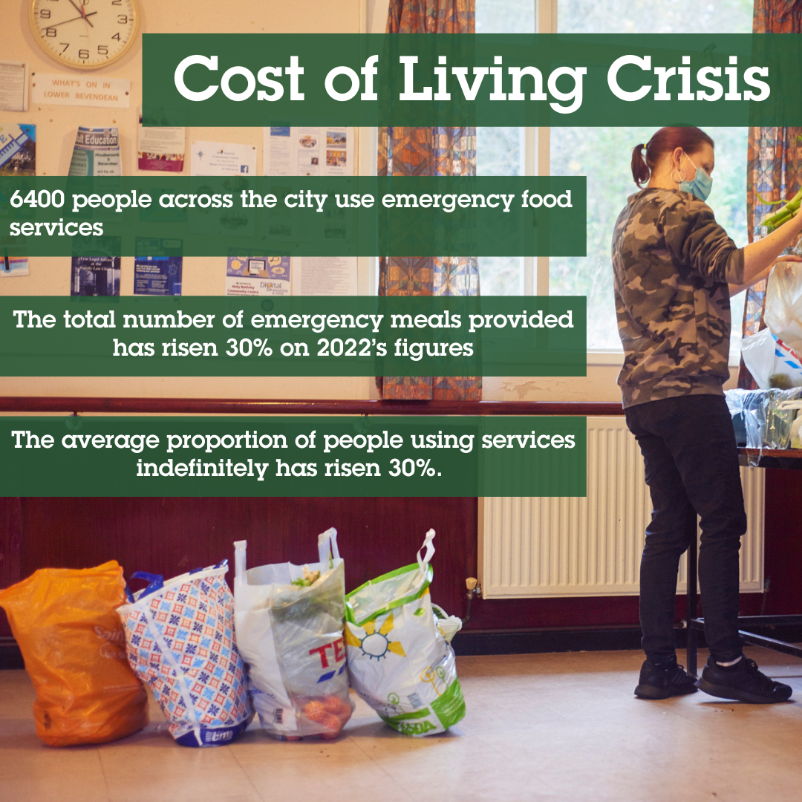
Emergency Food Network and Cost of Living Crisis response
Take enquiries by phone and email and web. Nearly 11,000 visits to our website for the food poverty resources last year
Support networks of community projects
Emergency food survey (10th year) and campaign asks
Bridging Change Report into food access needs of Black, Asian and Minority Ethnic, Refugees and Asylum seekers
Food Insecurity Group (cross sector work BHCC and community and voluntary sector)
Food SOS and Crowdfunding

Slide 8



Being part of a national and international research and partnerships
FoodSEqual. UKRI project. 4 different cities (Brighton, London, Reading, and Plymouth).Recruited and trained 4 new community researchers. 9 focus groups with 64 attendees, focussing conversations on pulses and fish.

Slide 9
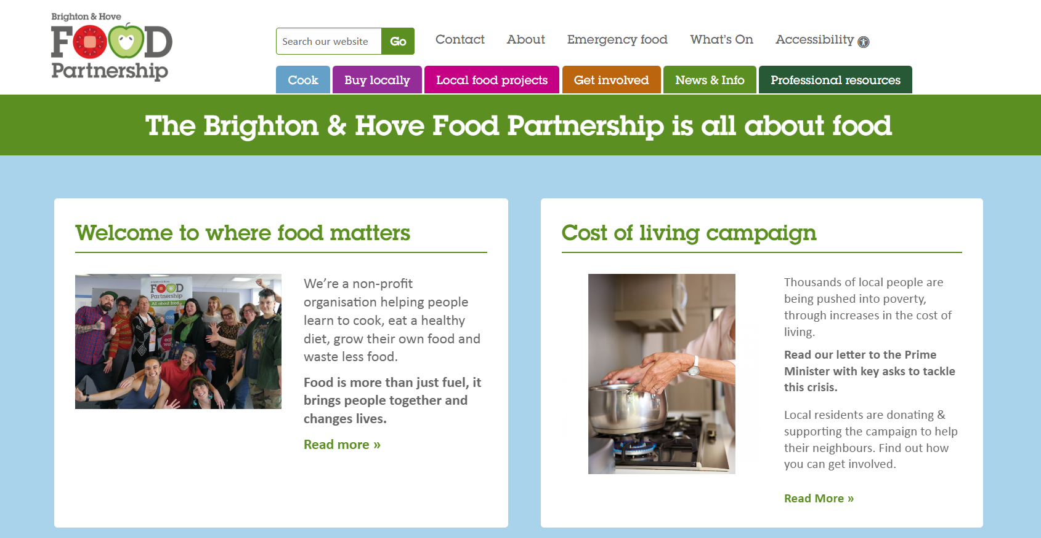
Hub for information, connection and inspiration
Website, newsletter and social
Started to use reels more
Fundraising campaign with Citizen’s Advice raised £75K
First point of contact on phone email including for people in poverty needing food
Coming soon a Podcast series

Slide 10
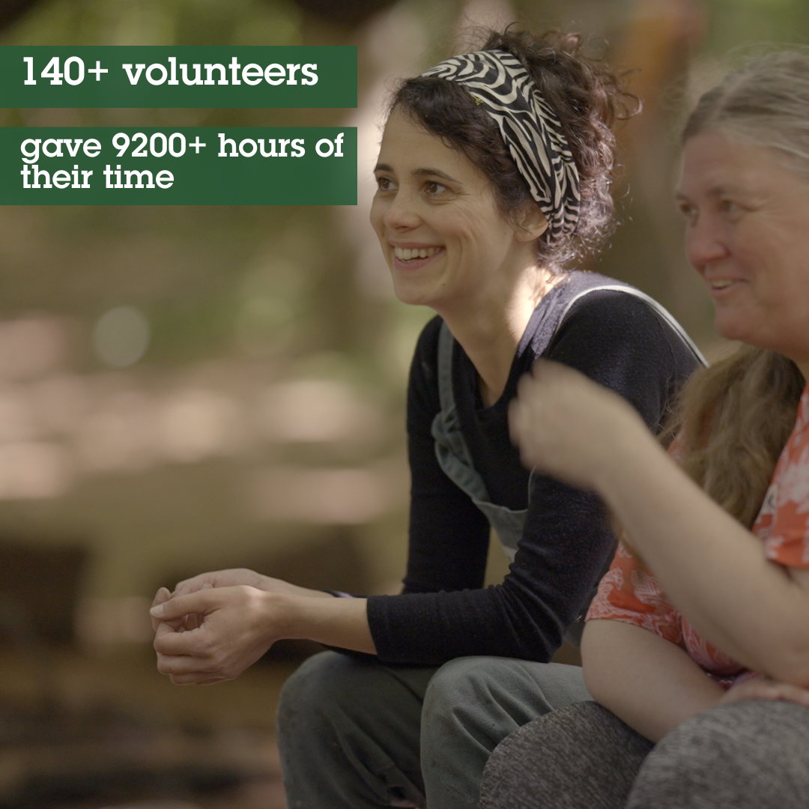

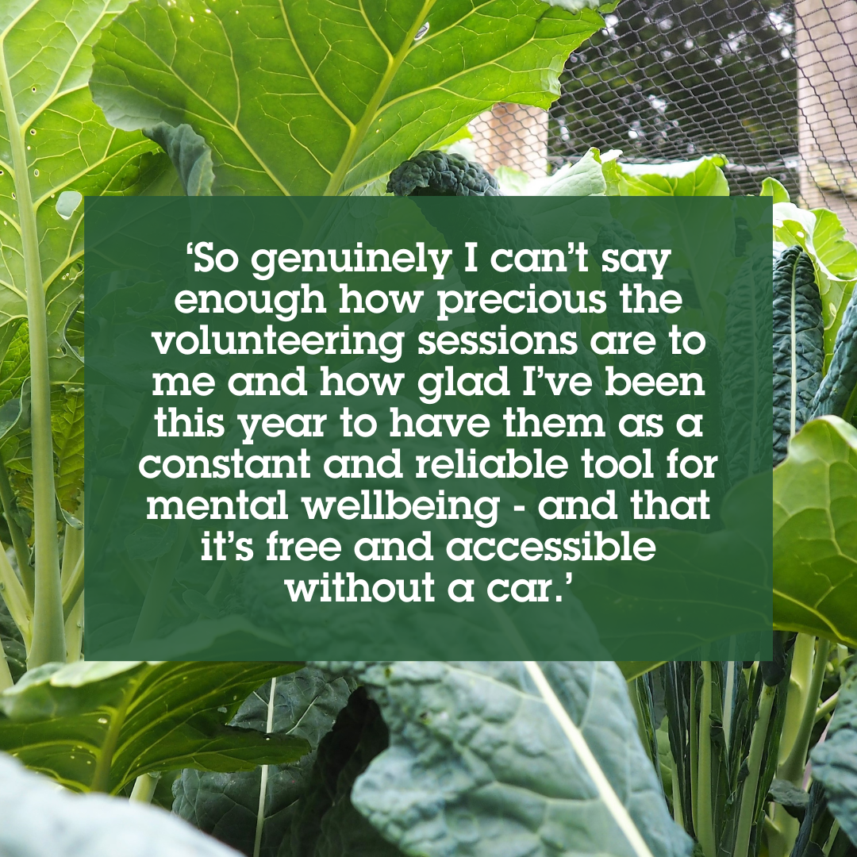

Staff and volunteers
27 people on payroll + team of sessional staff and freelancers
140 volunteers at any one time. Inc Board –thank you!
Paid Internship Scheme with University of Sussex
Ongoing work to improve re equality diversity and inclusion

Slide 11
….. And a Community Kitchen but more about that later!

Slide 12
Questions?

Slide 13
Setting up a NEW charitable organisation
History
Have applied for BHFP to be a charity twice (and appealed negative decision once). Most but not all of work of BHFP considered charitable therefore turned down
There are benefits to being a charity eg Gift Aid, sources of grants
Previous AGM of BHFP agreed that we would support the setting up a new charitable organisation
Called Community Kitchen Charity (CKC) has its own Board, own Mem & Arts and makes own decisions
Delays in applying due to pandemic. Slow process but have now had confirmation from charity commission of approval

Slide 14
Next steps
There will be a Memorandum of Understanding between the Boards of the Food Partnership and the CKC setting out how they will work together.
The CKC will fundraise for new work. It will work with BHFP (and other organisations) to deliver that work
Any longer term decisions about transferring activity / staff or resources from the Food Partnership to the CKC would have to come to an AGM

Slide 15
Questions?

Slide 16
Annual Accounts 2022/23
Have been prepared by Taylorcocks Accounts
Being presented by Vic Borrill.
Chance for questions
Accounts will be signed off at the next FP Board meeting (October) and filed with companies house

Slide 17
Income and expenditure summary
Page 6 | 2022/23 | 2021/22 | 2020/2021
Income | 1,060,875 | 819,803 | 961,315
Expenditure | 1,053226 | 817,907 | 955,463
Difference | 7,649 | 1,896 | 5,825
There may be a small amount of corporation tax due this year – TaylorCocks will calculate before accounts signed off

Slide 18
Sources of income
Whilst the amount of fee/ rent income increased by £26,300 because the overall income of the organisation increased remained at 13% of overall income
Grants / crowdfund / donations income continued to form majority of income
BHCC and the Big Lottery continue to provide significant investment

Slide 19
Deferred income - p12 and 13
Funding that was given at the end of the previous FY for work in 23/24
Upfront payments for work across two Financial Years
Amount being deferred to 23/24 = £125,629
Less than the FY 21/22 (£214,627) when there had been a lot of delays to work due to pandemic

Slide 20
Expenditure p18
27 people paid via payroll + freelance tutors / HR consultant and book-keeper
Role as lead partner / administering grants to smaller projects. The total amount of funding passed to other community organisations in the city was £194,296 30% of which was for emergency food work
In this financial year £192,000 of income / expenditure was associated with giving out vouchers, buying food and onward grants associated with the city’s food response to the Cost of Living crisis
Note 8 on page 15 sets out income and expenditure by work areas.

Slide 21
Questions?

